Slide 1


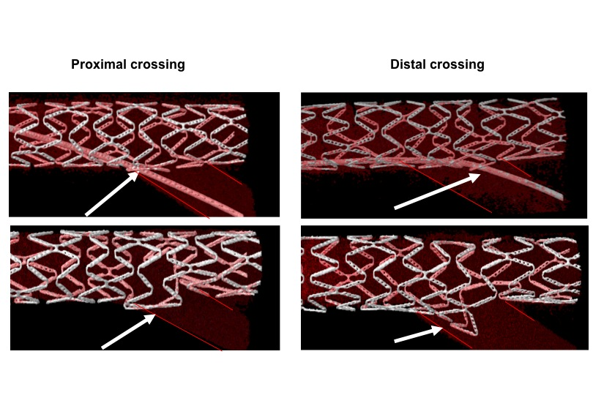

Bifurcation lesions (old)
Figure 20
Schematic illustrating that crossing the distal stent strut covering the side branch ostium results in more favourable ostial stent geometry than crossing more proximally.
Thierry Lefèvre, Thomas Hovasse
©2025 Europa Group - All rights reserved.

