Slide 1


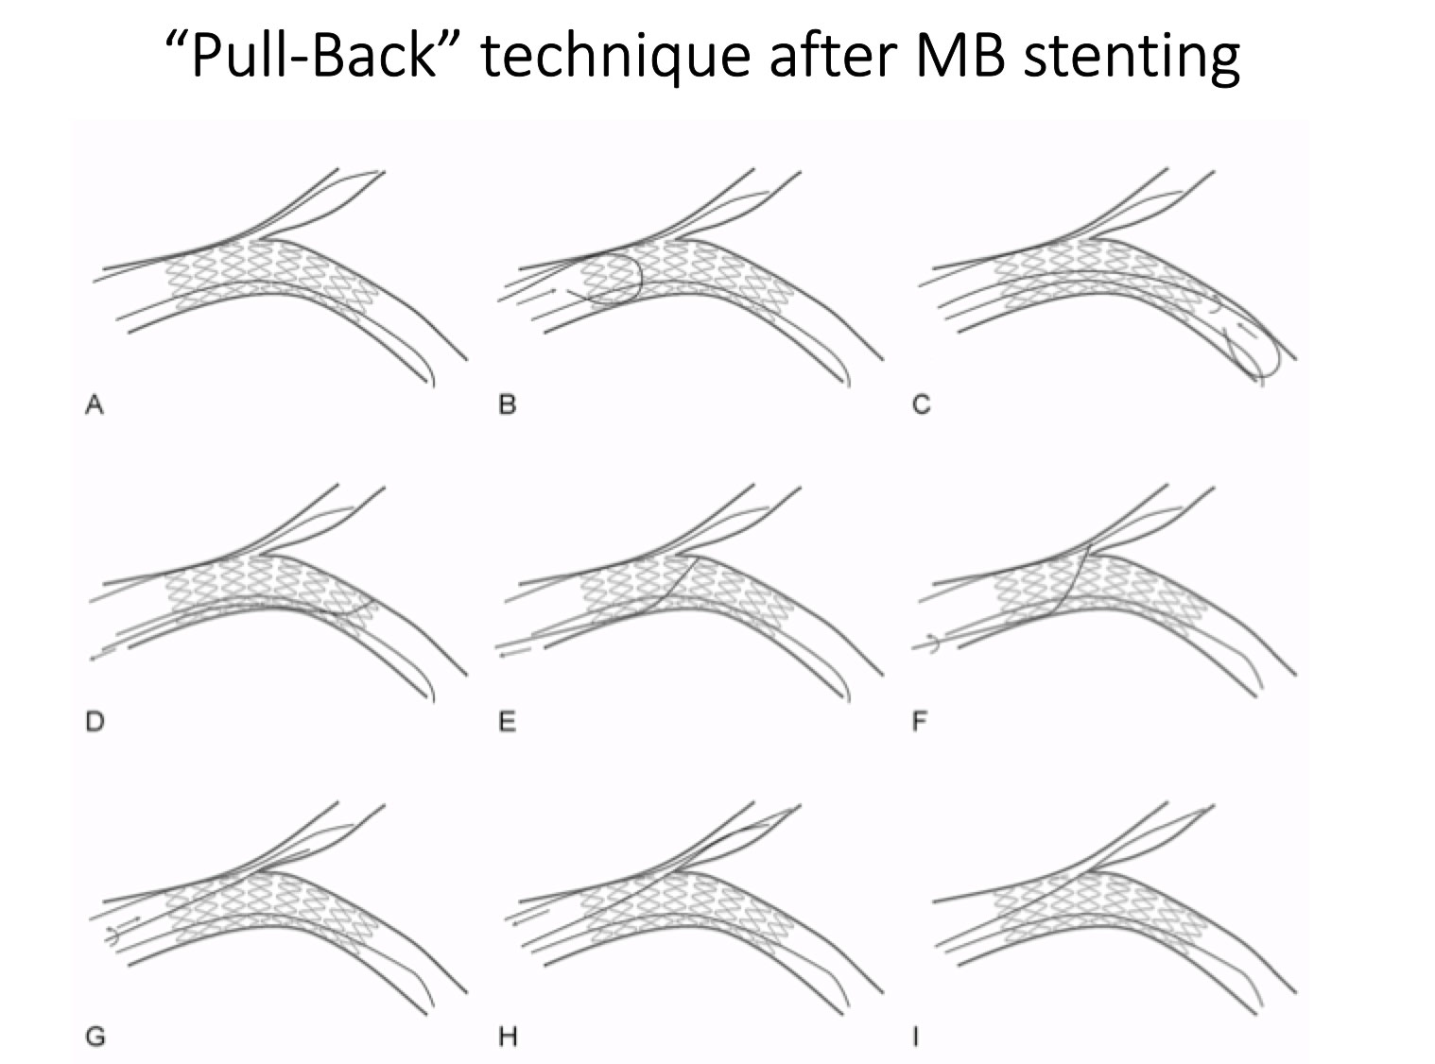
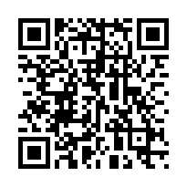
Bifurcation lesions (old)
Figure 21
Schematic illustrating the wire pull-back technique to enter the SB after MB stenting and POT. This technique facilitate also crossing tyhroug a distal strut.
Thierry Lefèvre, Thomas Hovasse
©2025 Europa Group - All rights reserved.

