Slide 1


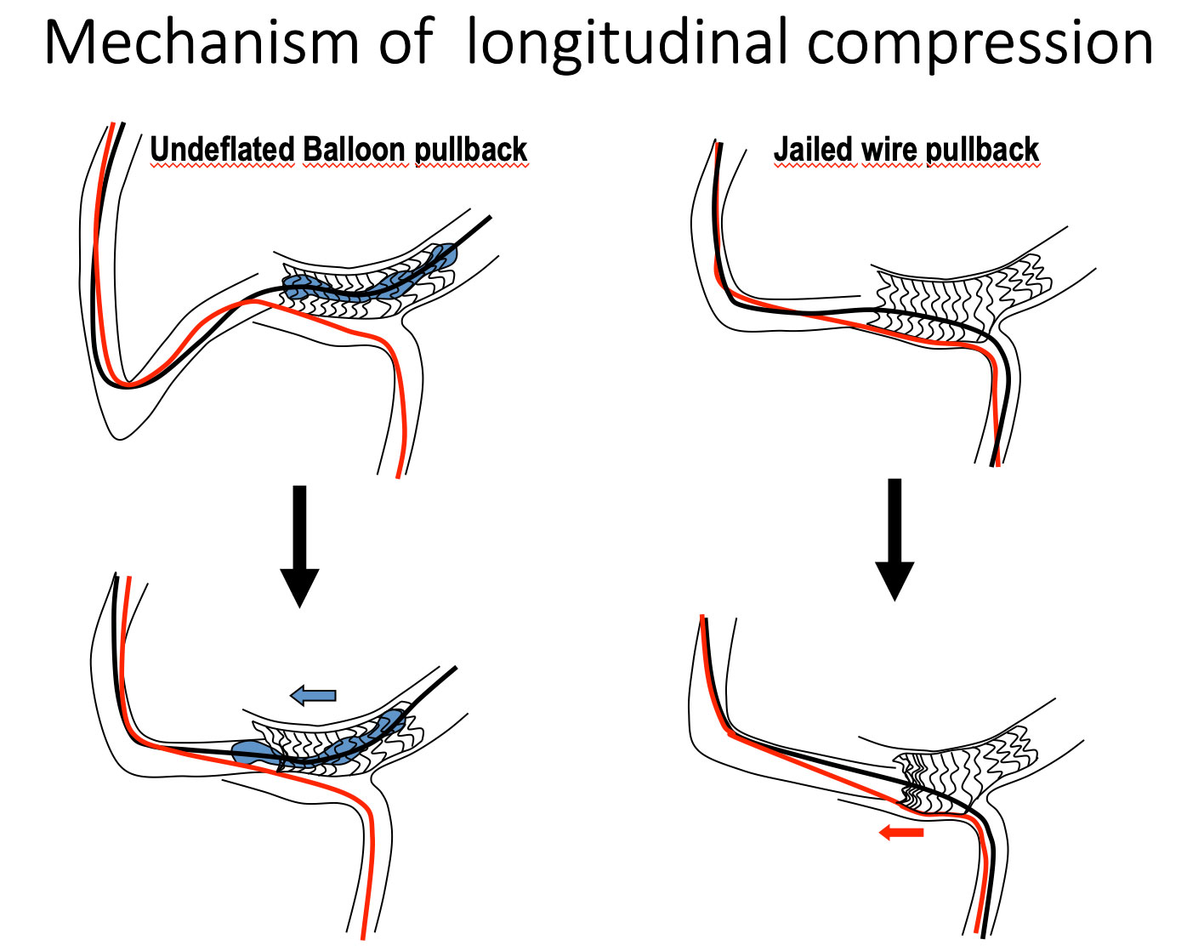

Bifurcation lesions (old)
Figure 22
Schematic illustrating the risk of longitudinal compression when pulling-back a non fully deflated balloon (left panel) or a jaide wire without control of the guiding catheter (left hand control).
Thierry Lefèvre, Thomas Hovasse
©2025 Europa Group - All rights reserved.

