Slide 1


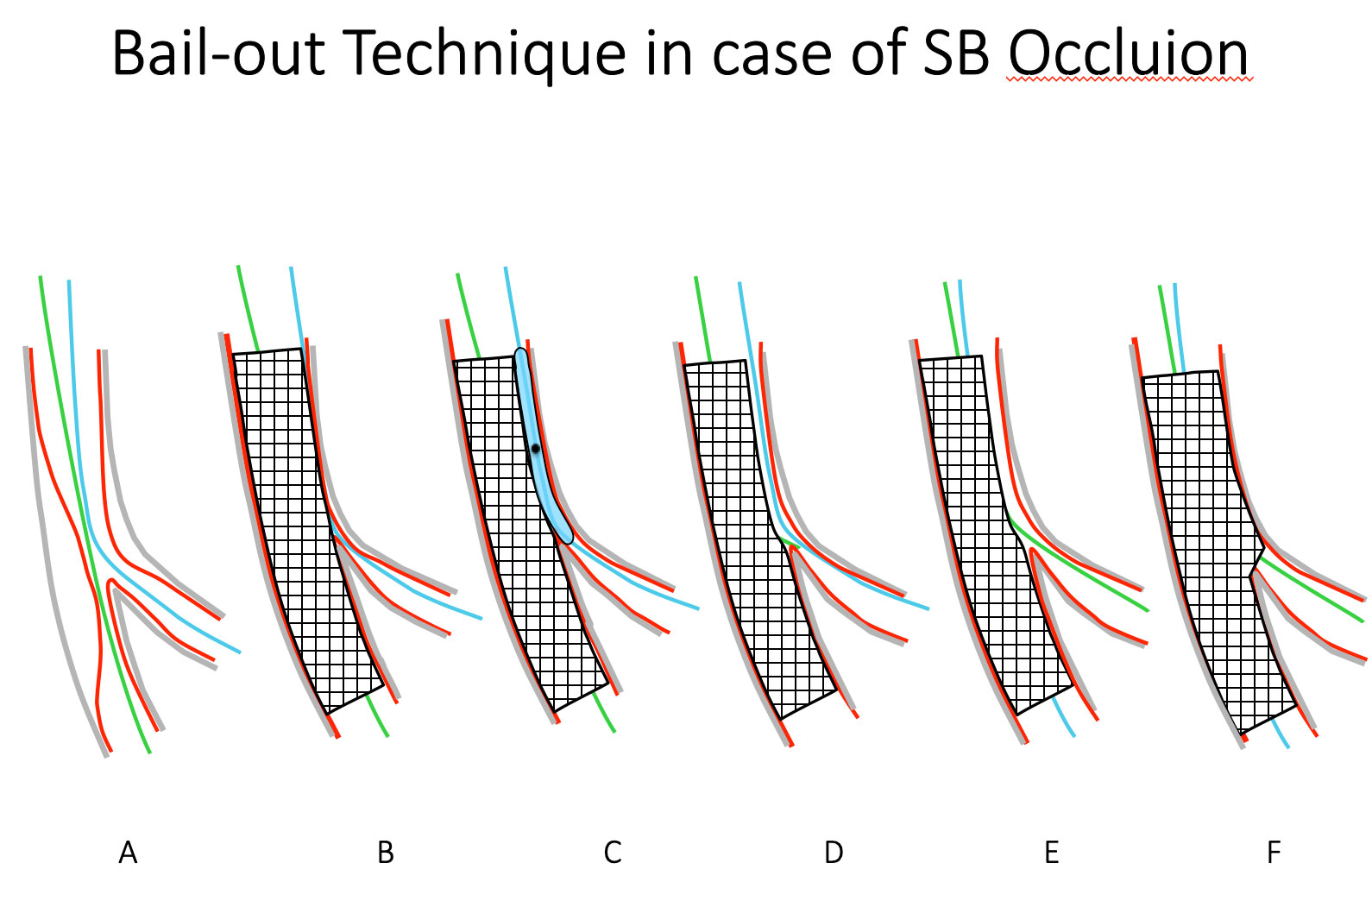
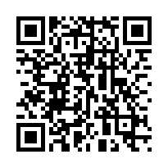
Bifurcation lesions (old)
Figure 23
Bailout technique in the case of ostial SB occlusion. Inflating a small diameter balloon on the SB wire behind the MB stent can re-open the SB ostium (left panel). The MB wire or a third wire can be used to cross the MB stent into the side branch.
Thierry Lefèvre, Thomas Hovasse
©2025 Europa Group - All rights reserved.

