Slide 1


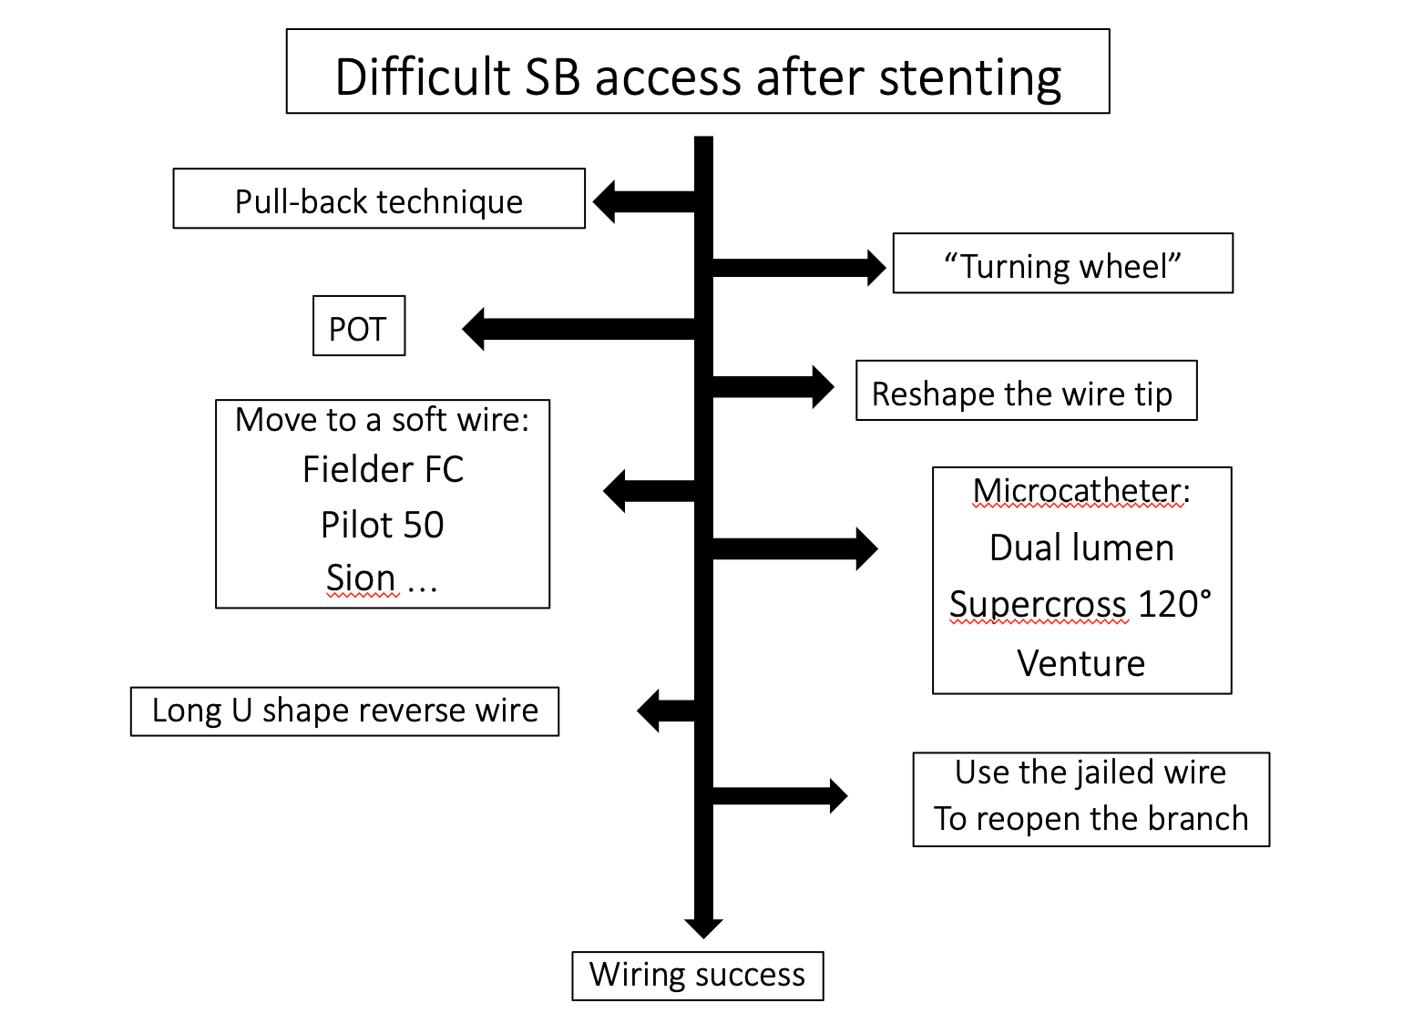

Bifurcation lesions (old)
Figure 24
Summary of SB access technical escalation after stenting
Thierry Lefèvre, Thomas Hovasse
©2025 Europa Group - All rights reserved.

