Slide 1


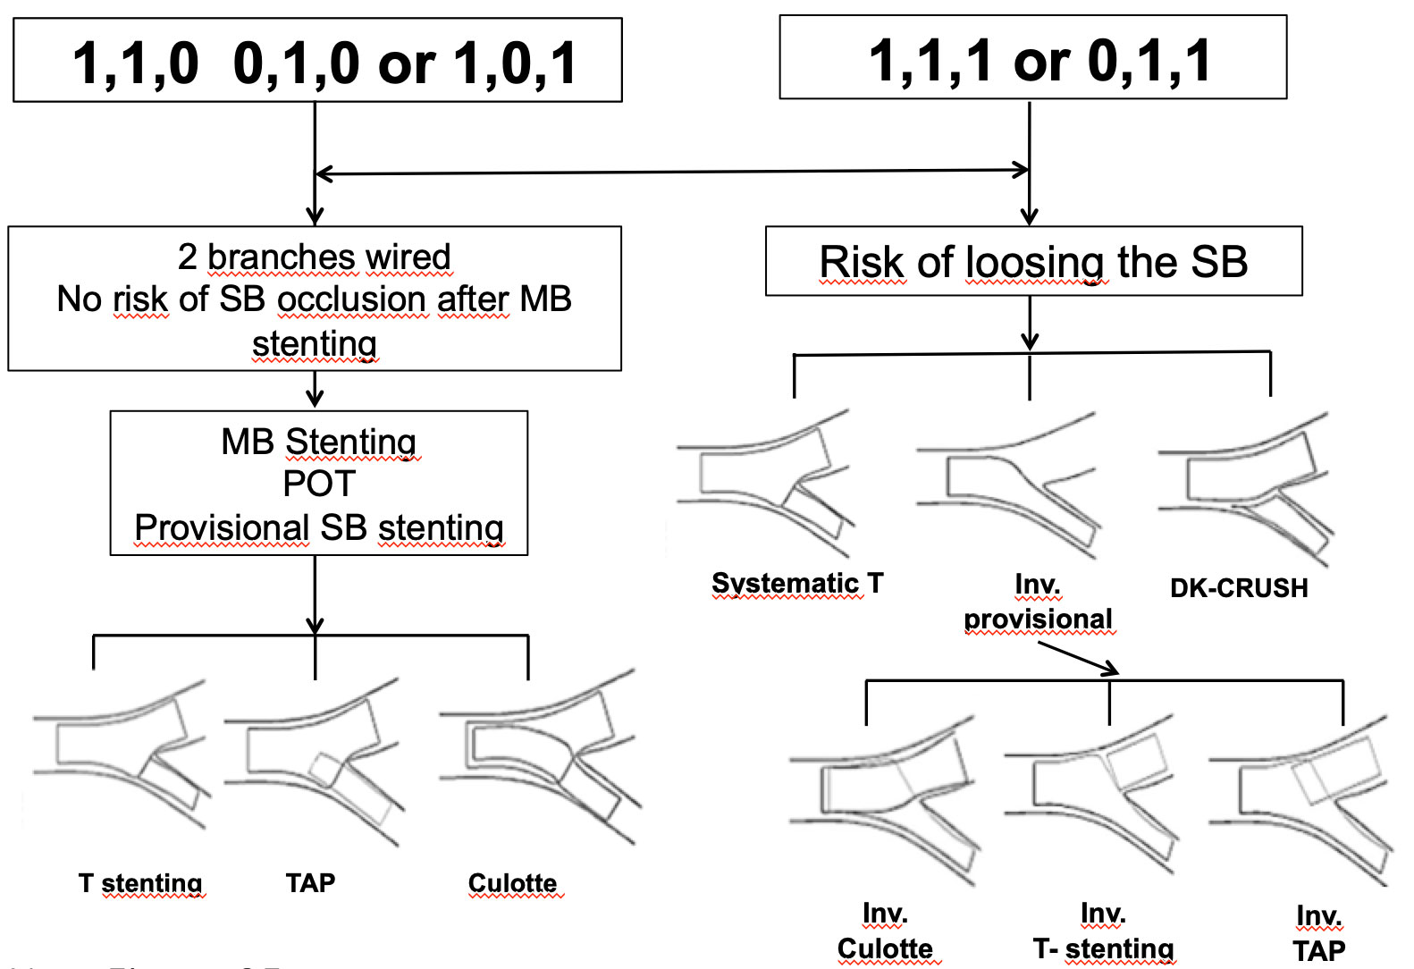

Bifurcation lesions (old)
Figure 25
A simplified technical algorythm when treating a bifurcation lesion
Thierry Lefèvre, Thomas Hovasse
©2025 Europa Group - All rights reserved.

