Slide 1


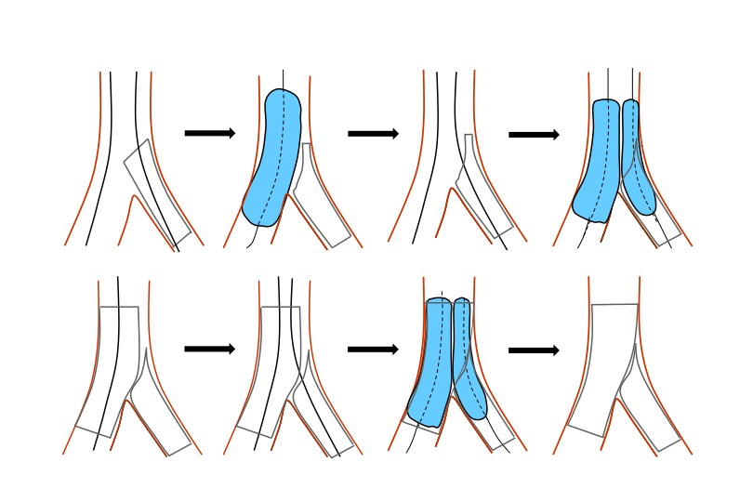

Bifurcation lesions (old)
Figure 26
The difference between T and TAP technique. An optimal view of the carena is crucial.
Thierry Lefèvre, Thomas Hovasse
©2025 Europa Group - All rights reserved.

