Slide 1


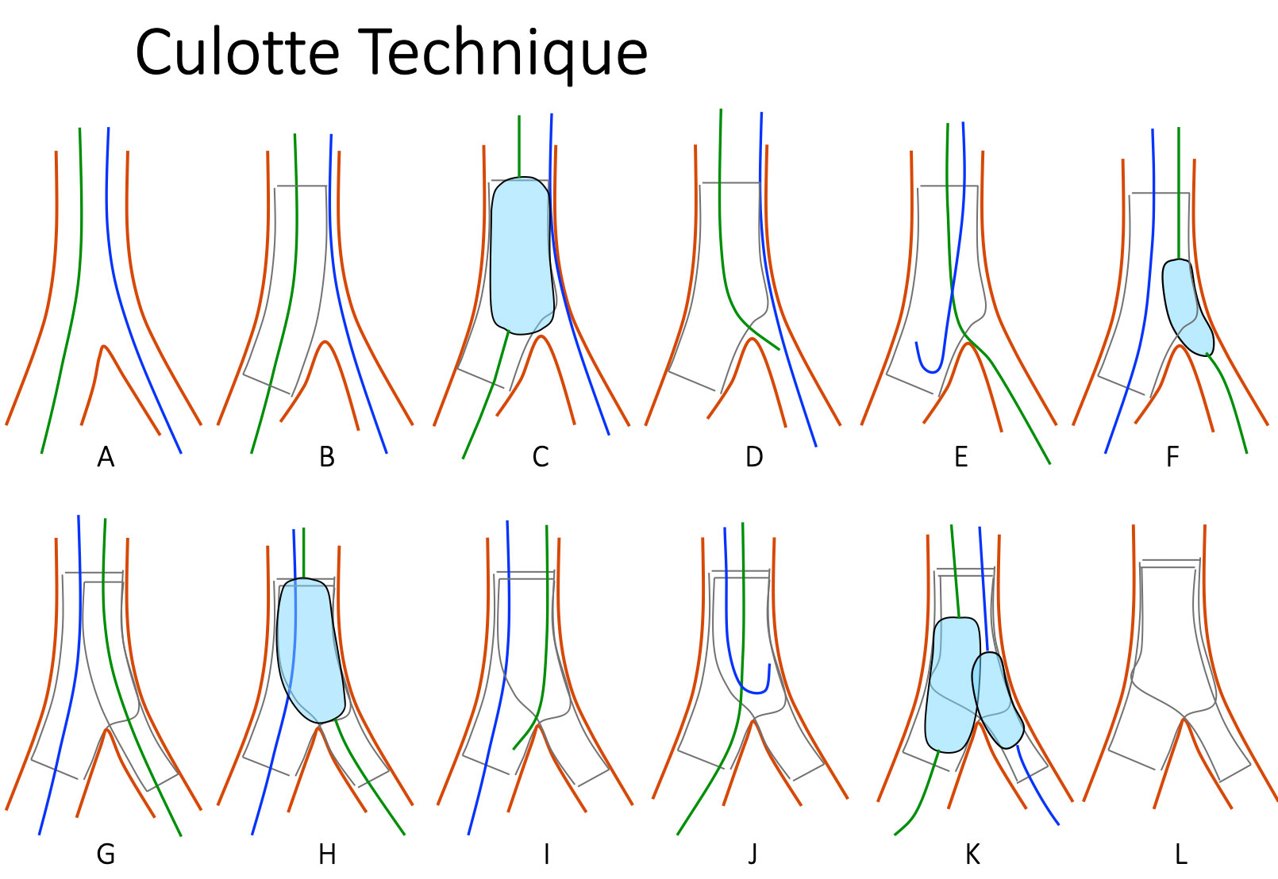

Bifurcation lesions (old)
Figure 27
Schematic drawings of the Strait Culotte Technique. This is a two-stent strategy for bifurcations. After wiring both branches, the first stent is deployed in the MB, POT is performed, SB is rewired and struts are opened, then a second stent from the PMV to the SB. After POT, the MB is rewired and a mandatory FKB is performed.
Thierry Lefèvre, Thomas Hovasse
©2025 Europa Group - All rights reserved.

