Slide 1


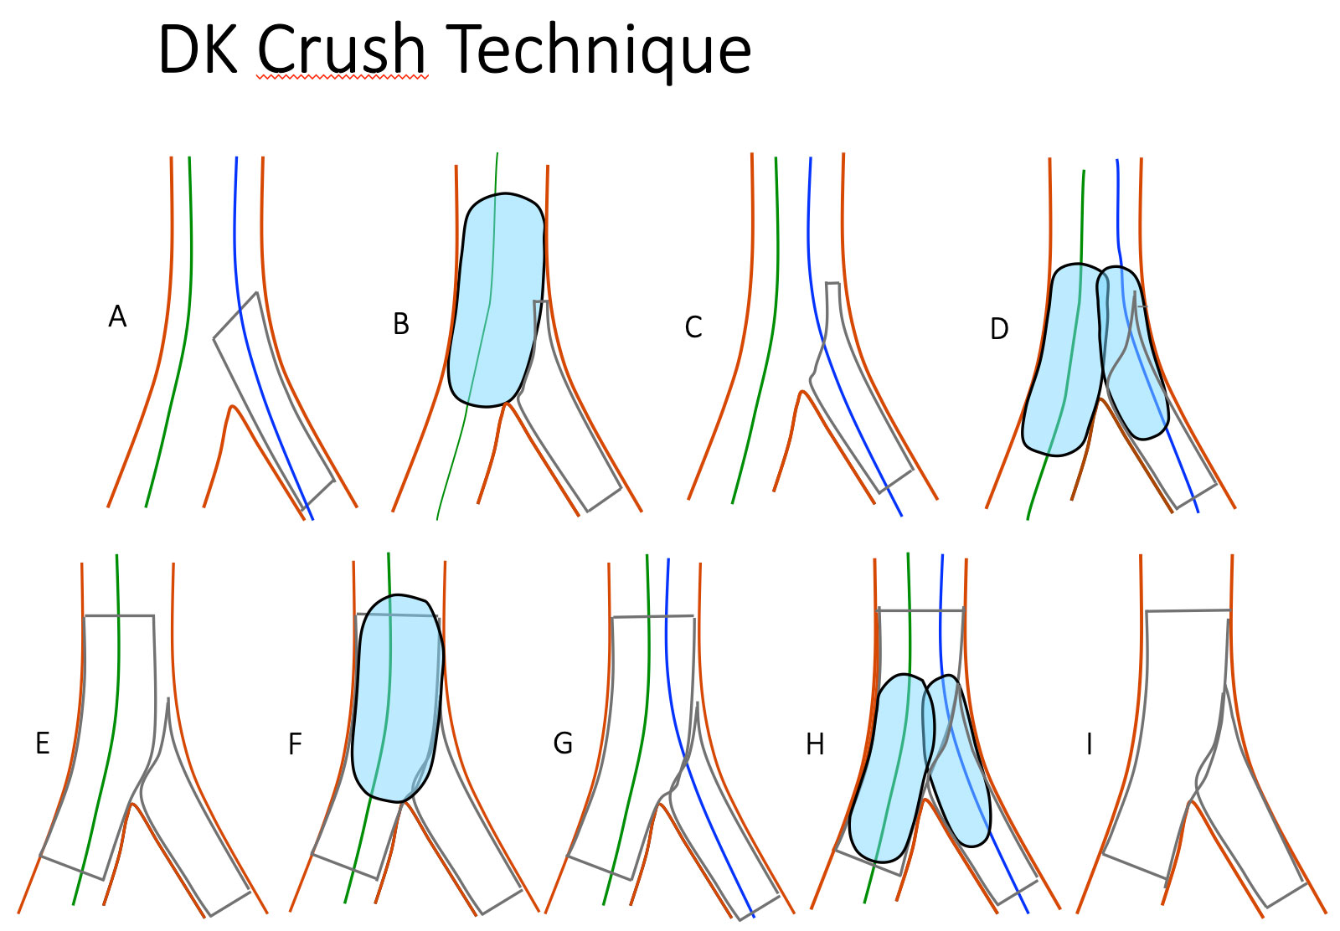
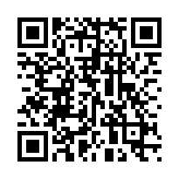
Bifurcation lesions (old)
Figure 29
DK-Crush technique step by step (A) SB Stenting with protrusion. (B) SB stent balloon crush. (C) proximal SB wire recrossing. (D) First kissing balloon inflation. (E) MB stenting across the SB. (F) POT. (G) Second SB wire recrossing. (H) Second kissing balloon inflation. (H) Final result. Final POT shoul be performed if long balloons are used for kissing.
Thierry Lefèvre, Thomas Hovasse
©2025 Europa Group - All rights reserved.

