Slide 1


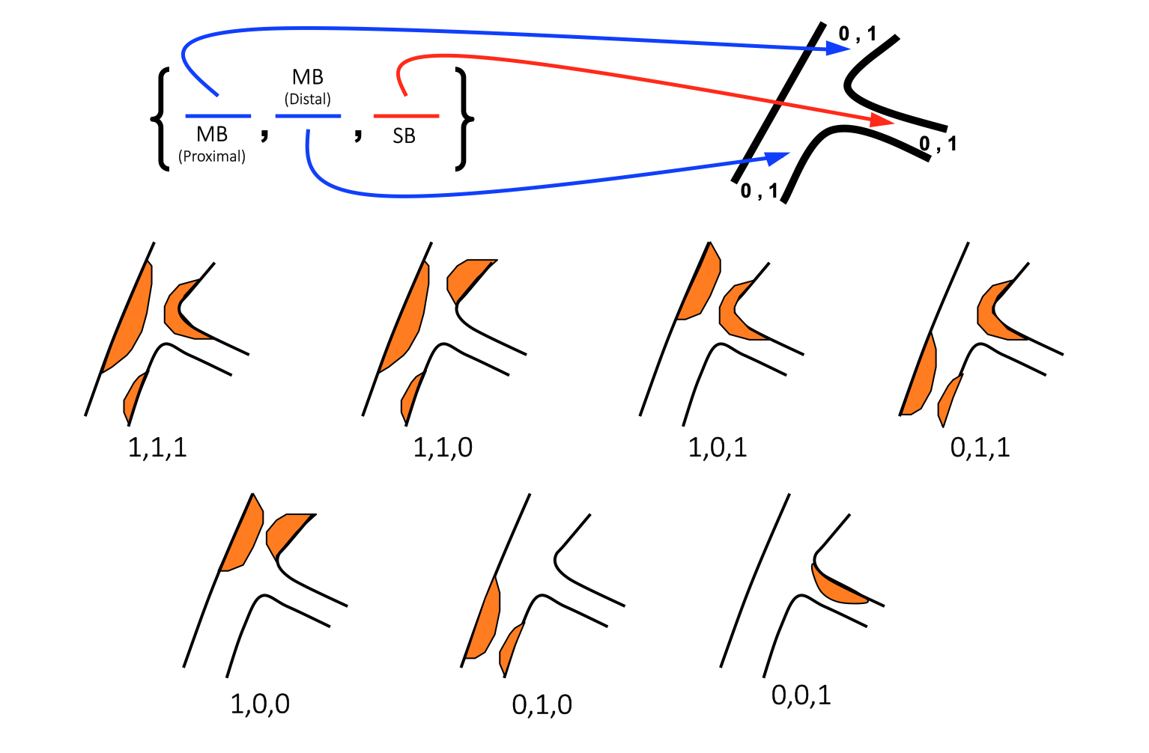

Bifurcation lesions (old)
Figure 3
Modified Medina classificationAn anatomical-based description of the three components of a bifurcation lesion. Before the first comma, 1 or 0 depending on the presence or not of > 50% stenosis in the proximal main vessel, between the two commas the same for distal main vessel, after the second comma the same for side branch (from A. Medina).
Thierry Lefèvre, Thomas Hovasse
©2025 Europa Group - All rights reserved.

