Slide 1


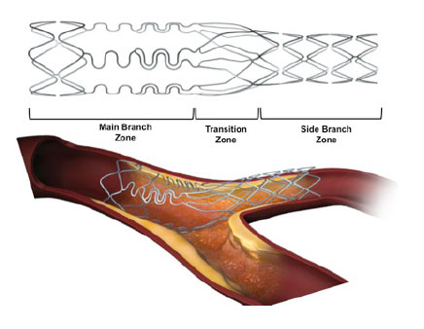

Bifurcation lesions (old)
Figure 30
Schematic drawing of the deployed Tryton stent platform showing it’s different components. The wide stent strut aperture over the transition zone facilitates wiring of the main branch and passage of equipment.
Thierry Lefèvre, Thomas Hovasse
©2025 Europa Group - All rights reserved.

