Slide 1


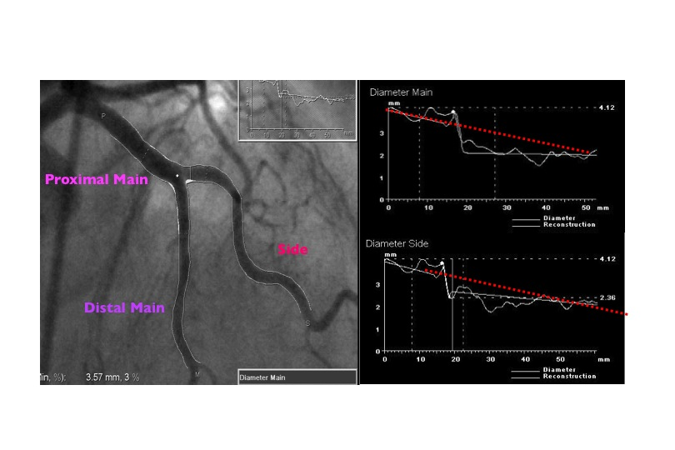

Bifurcation lesions (old)
Figure 4
An example of dedicated bifurcation QCA softwareThe reference functions from PM to DM and from PM and SB are not linear as usual (red dotted line), but constant proximal and distal to the bifurcation and stepped at the level of the bifurcation (from P. Serruys).
Thierry Lefèvre, Thomas Hovasse
©2025 Europa Group - All rights reserved.

