Slide 1


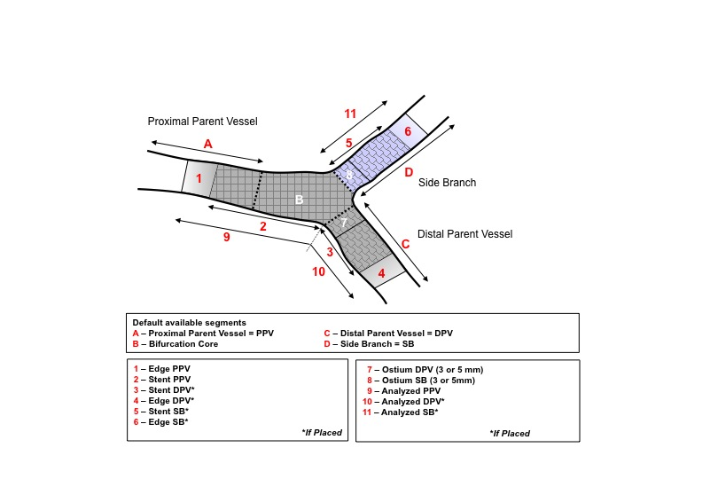

Bifurcation lesions (old)
Figure 5
EBC proposal for presentation of bifurcation QCA results. (11 segments) (from A. Lansky)
Thierry Lefèvre, Thomas Hovasse
©2025 Europa Group - All rights reserved.

