Slide 1


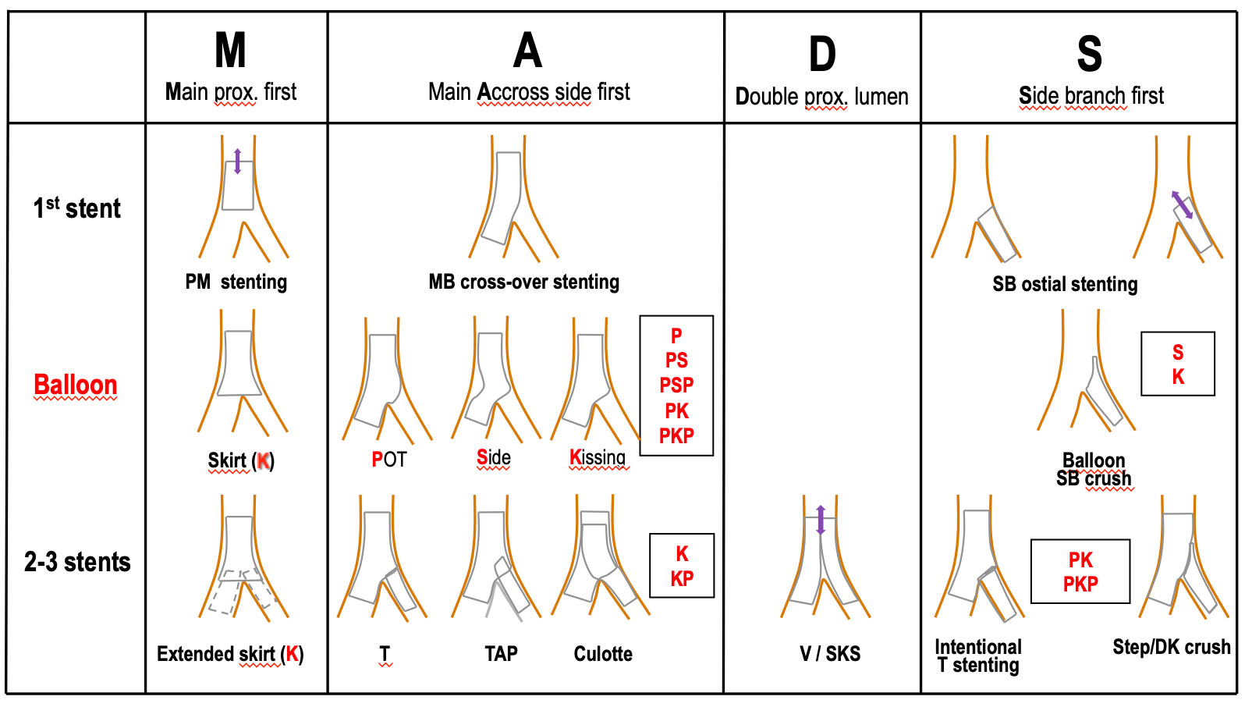

Bifurcation lesions (old)
Figure 6
An operational description of the possible permutations when stenting a bifurcation lesion MADS classification (2019)
Thierry Lefèvre, Thomas Hovasse
©2025 Europa Group - All rights reserved.

