Slide 1


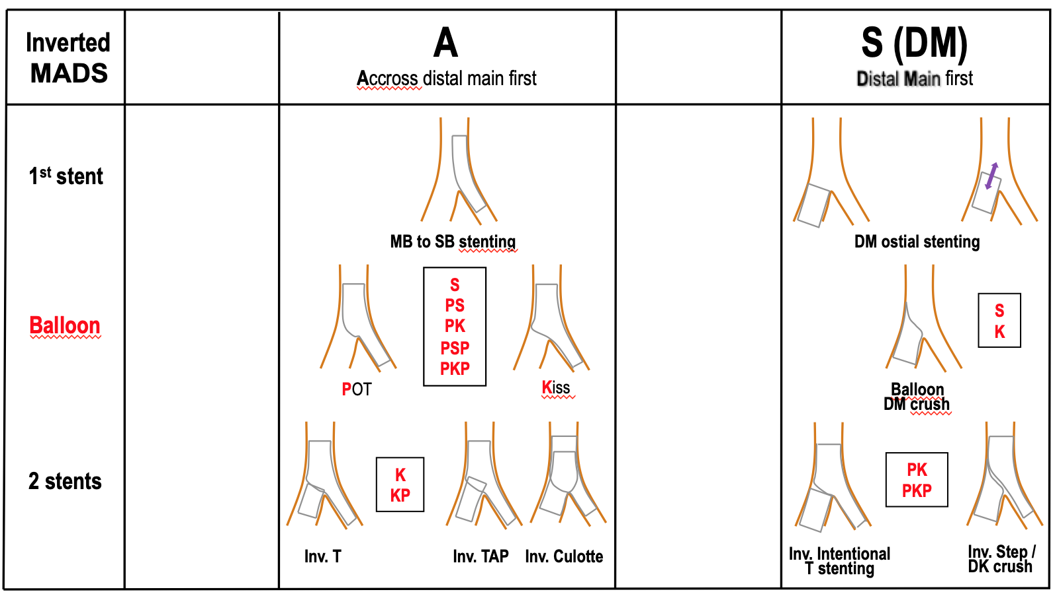

Bifurcation lesions (old)
Figure 7
Updated MADS classification of inverted techniques (2019)
Thierry Lefèvre, Thomas Hovasse
©2025 Europa Group - All rights reserved.

