Slide 1


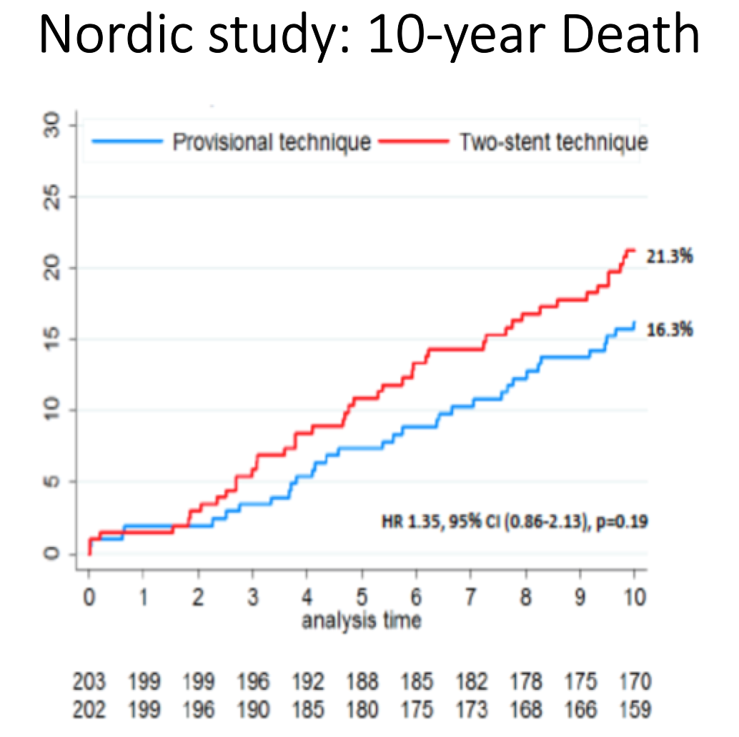

Bifurcation lesions (old)
Figure 8
10 years death rate in the Nordic study (Provisional vs 2 systematic stents). From Steigen et al. TCT 2016
Thierry Lefèvre, Thomas Hovasse
©2025 Europa Group - All rights reserved.

