Slide 1


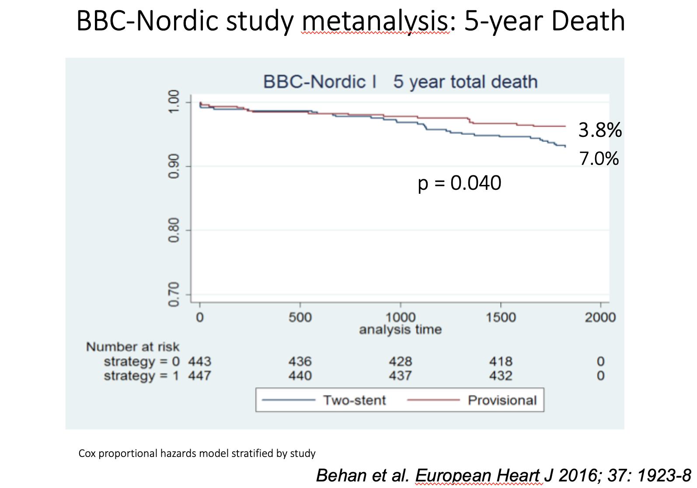

Bifurcation lesions (old)
Figure 9
5 years death rate in the BBC-Nordic metanalysis (provisional vs sytematic two stents). From Behan et al. (reference 307)
Thierry Lefèvre, Thomas Hovasse
©2025 Europa Group - All rights reserved.

