Slide 1


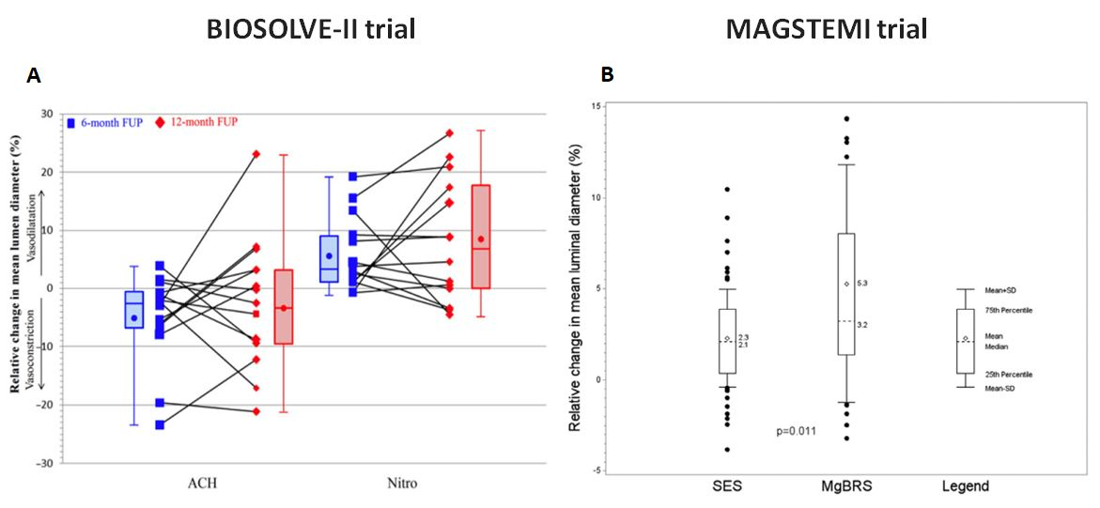

Bioresorbable scaffolds
Figure 10
Change in vasomotion after implantation of DREAMS2G/Magmaris. Panel A shows a change in vasomotion between 6 and 12 months in BIOSOLVE-II trial (78). Percentage change in mean lumen diameter after acetylcholine and after subsequent intracoronary injection of nitroglycerine at 6 and 12 months in 14 patients. There was no statistical significant difference between 6 and 12 months (P=0.808 for acetylcholine and = 0.626 for nitroglycerine). Panel B shows an endothelial-independent vasomotor response in MAGSTEMI trial (79). At 1 year, the rate of increase after nitroglycerin in mean lumen diameter of the in-stent/scaffold segment was significantly higher in the MgBRS arm (56.5% versus 33.8%; P=0.010).
Kai Ninomiya, Scot Garg, Alexandre A. Abizaid, Ron Waksman, Ashok Seth,
Joanna Wykrzykowska, John A. Ormiston, Patrick W. Serruys, Yoshinobu Onuma
©2025 Europa Group - All rights reserved.

