Slide 1


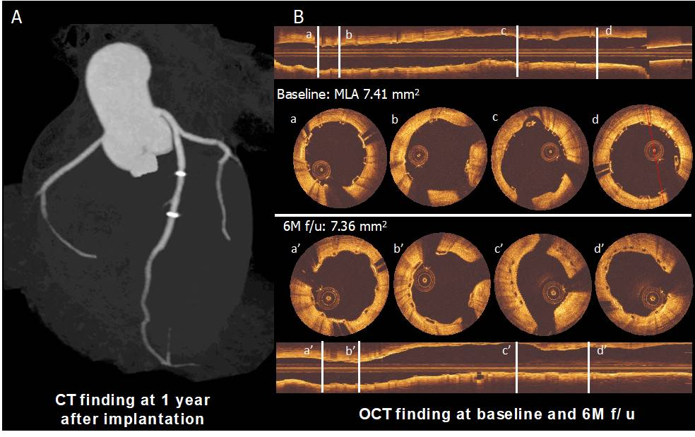

Bioresorbable scaffolds
Figure 11
Panel A shows the computed tomography angiography (CTA) finding at 1 year after implantation. Panel B shows post-implantation and six-month follow-up OCT images. The struts are observed as preserved boxes in the baseline images while the follow-up images show open boxes because of scaffold dissolution. At six-month follow-up, the neointimal coverage of the struts is presented as the membranous bridging pattern between the open boxes (94).
Kai Ninomiya, Scot Garg, Alexandre A. Abizaid, Ron Waksman, Ashok Seth, Joanna Wykrzykowska, John A. Ormiston, Patrick W. Serruys, Yoshinobu Onuma
©2025 Europa Group - All rights reserved.

