Slide 1


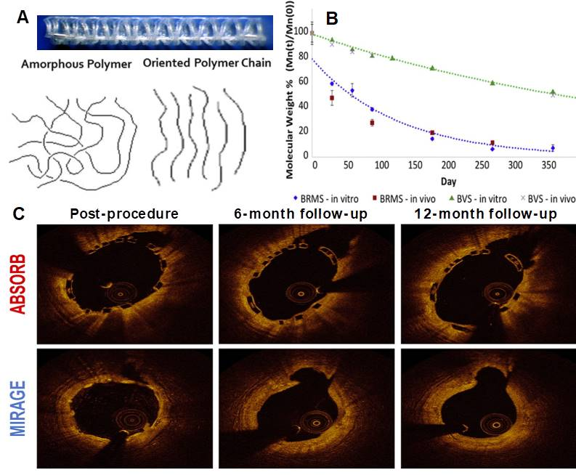

Bioresorbable scaffolds
Figure 12
Panel A shows highly oriented polylactide polymer extruded and annealed to form a circular monofilament with preferred directional mechanical properties. Panel B shows the in vitro and in vivo degradation profile in comparison with the BVS and confirms that the Mirage polylactide is basically fully biodegraded after 14 months. Panel C shows Optical Coherence Tomographic follow-up of the Absorb and Mirage scaffolds (97).
Kai Ninomiya, Scot Garg, Alexandre A. Abizaid, Ron Waksman, Ashok Seth,
Joanna Wykrzykowska, John A. Ormiston, Patrick W. Serruys, Yoshinobu Onuma
©2025 Europa Group - All rights reserved.

