Slide 1


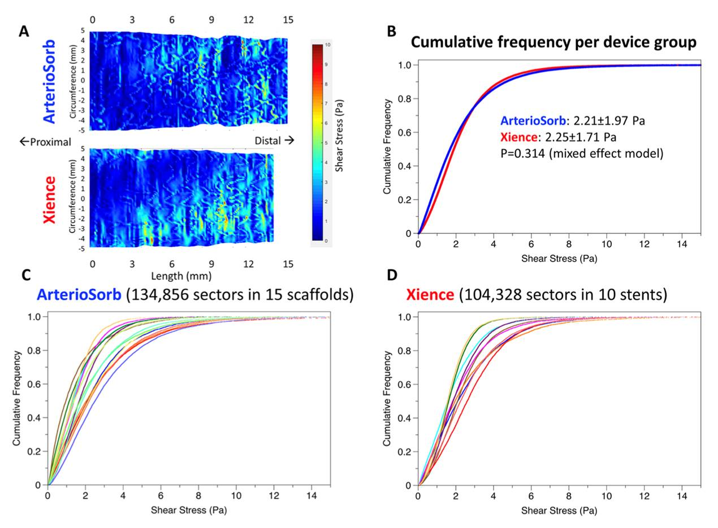
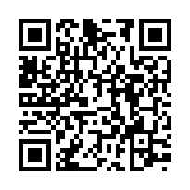
Bioresorbable scaffolds
Figure 15
Clinical outcomes of new generation BRS from Asian technologies. Currently the results of 4 BRS companies (Firesorb, XINSORB, NeoVas, Bioheart) were published. The rate of target lesion failure of Firesorb, XINSORB, NeoVas, and Bioheart at 1 year were 0.9%, 2.5%, 4,3%, and 4,4%, respectively (105, 108, 111, 114).
Kai Ninomiya, Scot Garg, Alexandre A. Abizaid, Ron Waksman, Ashok Seth, Joanna Wykrzykowska, John A. Ormiston, Patrick W. Serruys, Yoshinobu Onuma
©2025 Europa Group - All rights reserved.

