Slide 1


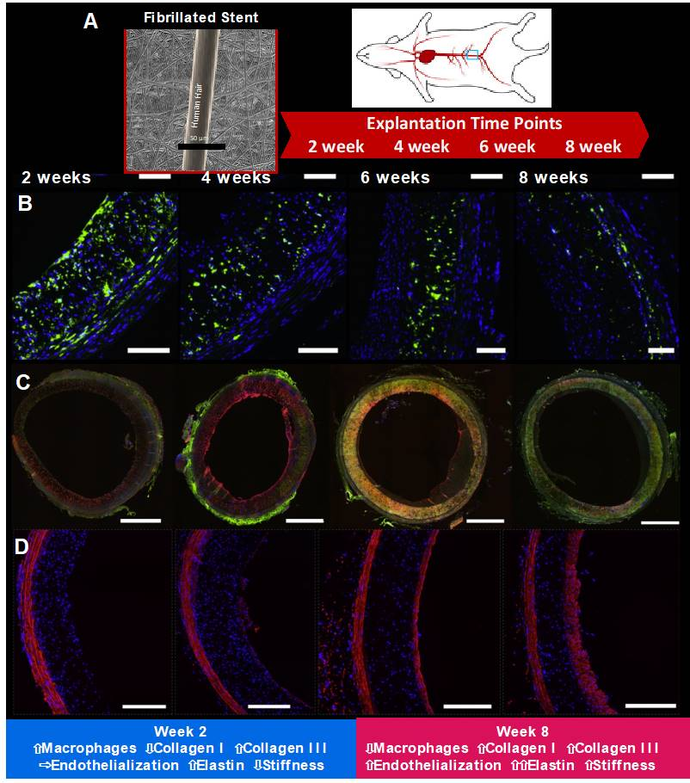

Bioresorbable scaffolds
Figure 16
STENTiT has a unique technological platform where support grafts are composed of polymeric microfibers, processed by electrospinning. This scaffold was evaluated in the abdominal aorta of 16 rats, equally divided into four groups with follow-up times of 2, 4, 6, and 8 weeks (Panel A) (118). Panel B shows macrophage presence. Immunofluorescent co-staining of CD68 (a pan-macrophage marker) (green) and cell nuclei (blue). Panel C shows collagen types I and III. Immunofluorescent co-staining of collagen type I (green), collagen type III (red), and cell nuclei (blue). Panel D shows elastin. Immunofluorescent co-staining of elastin (red) and cell nuclei (blue).
Kai Ninomiya, Scot Garg, Alexandre A. Abizaid, Ron Waksman, Ashok Seth,
Joanna Wykrzykowska, John A. Ormiston, Patrick W. Serruys, Yoshinobu Onuma
©2025 Europa Group - All rights reserved.

