Slide 1


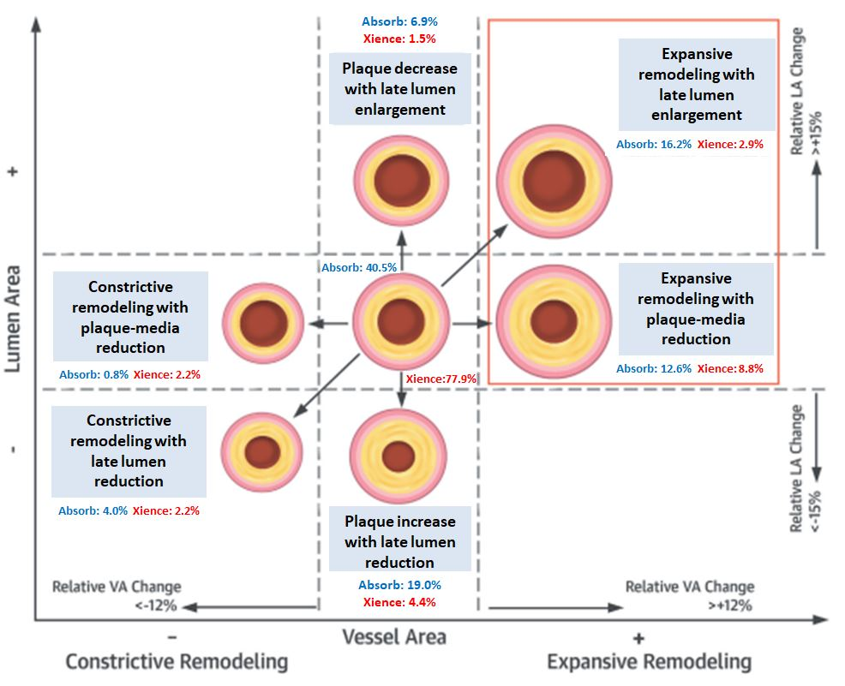

Bioresorbable scaffolds
Figure 17
Relative changes in vessel area (VA) (constrictive remodeling +12%) and relative changes in lumen area (LA) (lumen reduction +15%) defined remodeling patterns. No lesions showed constrictive remodeling with LA increase or expansive remodeling with LA decrease. Expansive vessel wall remodeling was more frequent with the bioresorbable vascular scaffold (BVS) than the metallic drug-eluting stent (DES) and could be determined by patient baseline characteristics and periprocedural factors (128).
Kai Ninomiya, Scot Garg, Alexandre A. Abizaid, Ron Waksman, Ashok Seth,
Joanna Wykrzykowska, John A. Ormiston, Patrick W. Serruys, Yoshinobu Onuma
©2025 Europa Group - All rights reserved.

