Slide 1


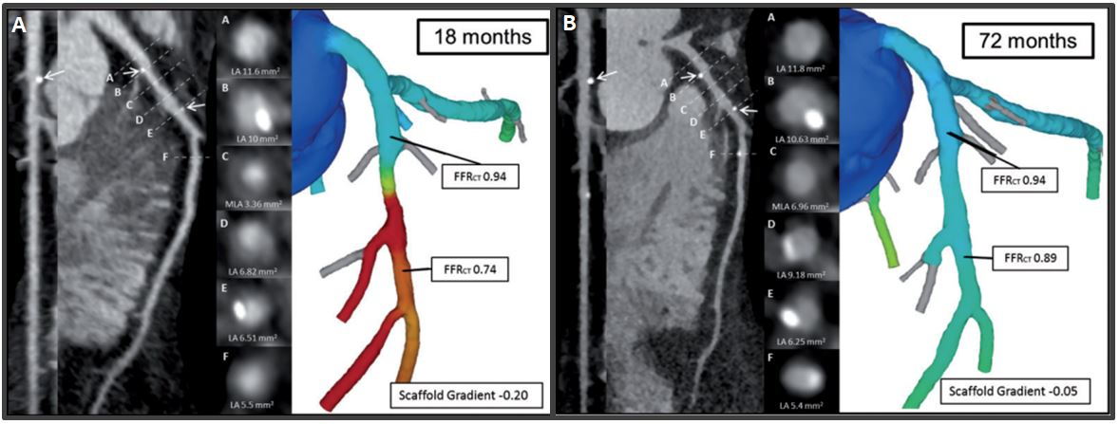

Bioresorbable scaffolds
Figure 18
Case example of serial MSCT with FFRCT at follow-up. Case example of a patient treated with a Bioresorbable Vascular Scaffold (white arrows) in the proximal segment of the left Circumflex artery. At 18 months (A), MSCT Angiography showed a patent scaffold with MLA of 3.1 mm2 and FFRCT scaffold gradient of 4. At 72 months (B), the persistence of the normalization of the FFRCT in-scaffold with the same gradient was found. However, in the distal edge of the scaffolded region plaque progression with a reduction of the luminal area and FFRCT was observed (130).
Kai Ninomiya, Scot Garg, Alexandre A. Abizaid, Ron Waksman, Ashok Seth, Joanna Wykrzykowska, John A. Ormiston, Patrick W. Serruys, Yoshinobu Onuma
©2025 Europa Group - All rights reserved.

