Slide 1


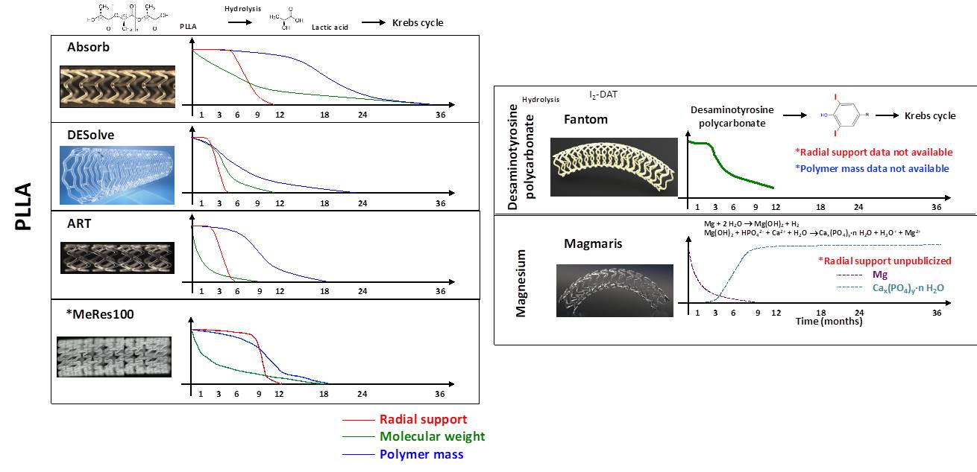

Bioresorbable scaffolds
Figure 3
Biodegradation process of CE-mark approved BRS. Current BRS are composed of either a polymer or a bioresorbable metallic alloy. Numerous different polymers are available, each with different chemical composition, mechanical properties, and consequently bioabsorption times. BRS: bioresorbable scaffold, PLLA: poly-L-lactic acid, DAT: desaminotyrosine.
Kai Ninomiya, Scot Garg, Alexandre A. Abizaid, Ron Waksman, Ashok Seth, Joanna Wykrzykowska, John A. Ormiston, Patrick W. Serruys, Yoshinobu Onuma
©2025 Europa Group - All rights reserved.

