Slide 1


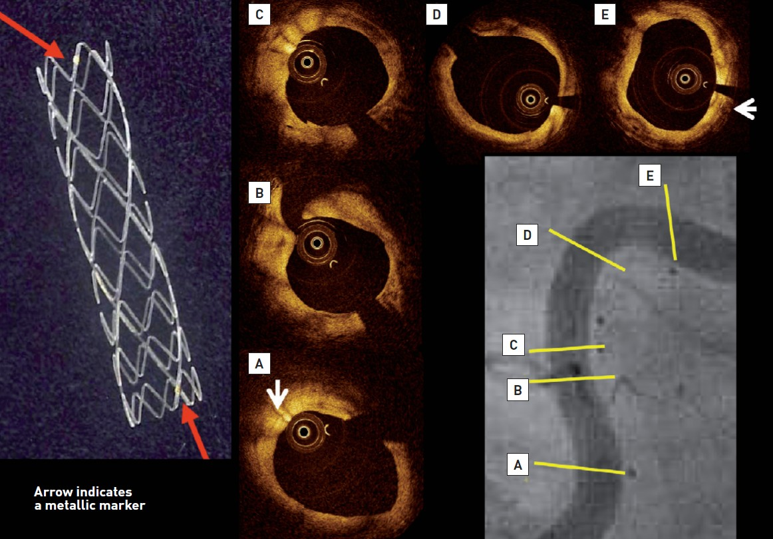

Bioresorbable scaffolds
Figure 4
The left panel demonstrates macroscopic view of the Igaki-Tamai PLLA stent, which has zig-zag helical coils with straight bridges and golden markers at both ends of the strut. The coronary angiography performed 10 years after implantation showed the patency and curved trajectory of the previously stented lesion in the proximal right coronary artery (Lower right panel). Stent markers of the overlapping IGAKI-TAMAI stents are clearly visible in the vessel wall. On OCT, endoluminal surface of the stent was smooth and struts were no longer visible, whereas radio-opaque markers remained detectable (white arrows).
Kai Ninomiya, Scot Garg, Alexandre A. Abizaid, Ron Waksman, Ashok Seth, Joanna Wykrzykowska, John A. Ormiston, Patrick W. Serruys, Yoshinobu Onuma
©2025 Europa Group - All rights reserved.

