Slide 1


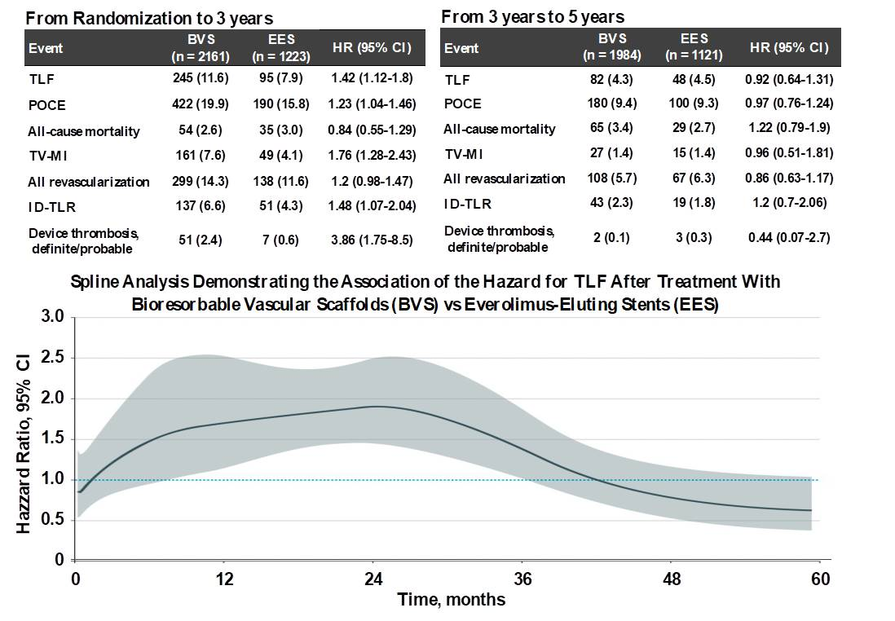

Bioresorbable scaffolds
Figure 5
Clinical outcomes between 0 to 3 years and 3 to 5 years. Between 0 and 3 years, TLF occurred in 11.6% of 2161 BVS-treated patients vs 7.9% of 1223 EES-treated patients (HR, 1.42; 95% CI, 1.12-1.80), whereas between 3 and 5 years, TLF occurred in 4.3% of 1984 at-risk BVS-treated patients vs 4.5% of 1121 at-risk EES- treated patients (HR, 0.92; 95% CI, 0.64-1.31, P for interaction = .046) (56). By spline analysis, the HR for the risk of BVS compared with EES for TLF was relatively constant at 1.5 to 2.0 between 6 and 30 months and then progressively declined. The lower bound of the 95% CI of the HR was less than 1.0 at 36 months and the HR was less than 1.0 at 42 months (below figure). (56)
Kai Ninomiya, Scot Garg, Alexandre A. Abizaid, Ron Waksman, Ashok Seth, Joanna Wykrzykowska, John A. Ormiston, Patrick W. Serruys, Yoshinobu Onuma
©2025 Europa Group - All rights reserved.

