Slide 1


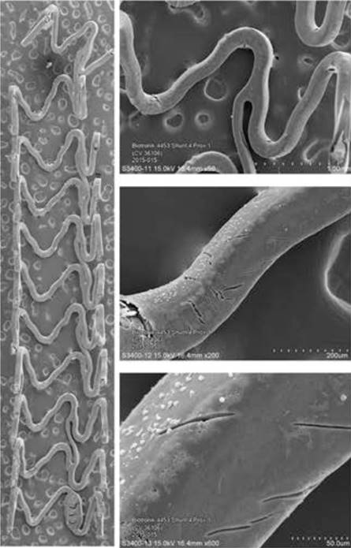

Bioresorbable scaffolds
Figure 6
Panel A shows scanning electron microscopy images of Magmaris. Representative low- and incremental high-power scanning electron microscopy images of Magmaris after a 1-hour shunt run in the porcine ex vivo arteriovenous shunt model. Stitched low-power montage images (×15 magnification) of the entire luminal surface were then assembled into a single image. Higher-power photographs of regions of interest were also taken at incremental magnifications of (×50, ×200, and ×600). Panel B and C show scanning electron microscopy images of Magmaris assessing thrombus deposition and inflammatory cell adherence. Representative scanning electron microscopy images (×200 and ×600 magnification [above and below, respectively]) of Magmaris after a 1-hour shunt run in the porcine ex vivo arteriovenous shunt model (69).
Kai Ninomiya, Scot Garg, Alexandre A. Abizaid, Ron Waksman, Ashok Seth,
Joanna Wykrzykowska, John A. Ormiston, Patrick W. Serruys, Yoshinobu Onuma
©2025 Europa Group - All rights reserved.

