Slide 1


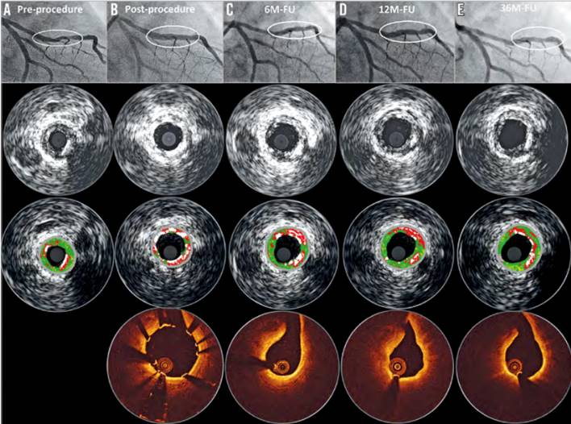

Bioresorbable scaffolds
Figure 7
Serial quantitative angiographic, intravascular ultrasound and OCT results of a patient with DREAMS 2G implantation. A) A lesion in the mid left anterior descending (type B2, length 14 mm, diameter 2.8 mm, diameter stenosis 80% by visual estimate). Predilatation was conducted with a 3.0×12 mm semi-compliant balloon. Thereafter, a DREAMS 2G scaffold (3.0×20 mm) was implanted. Post-dilatation was performed with a 3.0×12 mm semi-compliant balloon. B) Post-procedure OCT and intravascular ultrasound demonstrate a good conformability to the vessel and a metallic appearance of DREAMS 2G. C) At six months, the degradation of the scaffold is detectable, and the struts covering the side branch have disappeared. D) At 12 months, OCT shows homogeneous neointima formation. E) Preservation of the lumen without any restenosis at 36 months (74, 75).
Kai Ninomiya, Scot Garg, Alexandre A. Abizaid, Ron Waksman, Ashok Seth, Joanna Wykrzykowska, John A. Ormiston, Patrick W. Serruys, Yoshinobu Onuma
©2025 Europa Group - All rights reserved.

