Slide 1


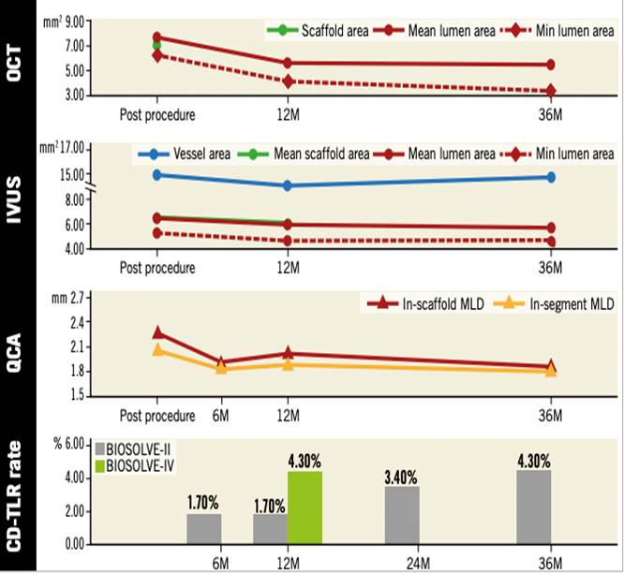

Bioresorbable scaffolds
Figure 8
Serial change on OCT, IVUS, and QCA after implantation of Magmaris. From one to three years, a mild increase of in-stent and in-segment late lumen loss (0.11±0.28 mm and 0.13±0.30 mm) was documented, resulting in a three-year in-device and in-segment minimal lumen diameter of 1.90±0.43 mm and 1.87±0.43 mm, respectively. Serial intravascular imaging by IVUS and OCT demonstrated stable lumen dimensions beyond 12 months (74). QCA data were based on non-paired analysis, whereas OCT and IVUS data were from paired analysis. BIOSOLVE-IV is an international single-arm registry which will include 2,054 patients. At one year, the TLF rate was 4.3%, driven by clinically indicated target lesion revascularisation (74, 75).
Kai Ninomiya, Scot Garg, Alexandre A. Abizaid, Ron Waksman, Ashok Seth,
Joanna Wykrzykowska, John A. Ormiston, Patrick W. Serruys, Yoshinobu Onuma
©2025 Europa Group - All rights reserved.

