Slide 1


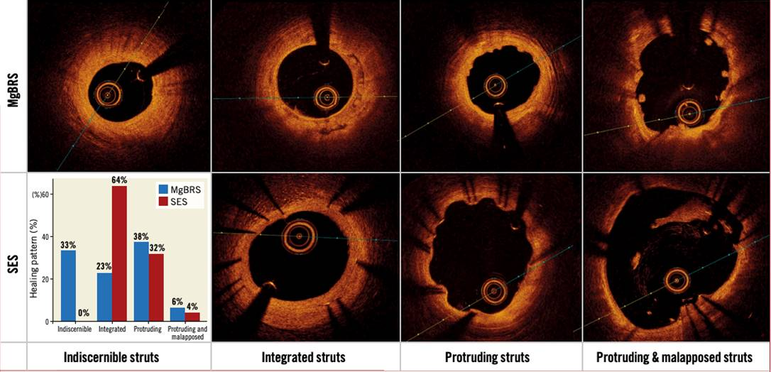

Bioresorbable scaffolds
Figure 9
Healing and bioresorption pattern from the randomised MAGSTEMI trial. Ninety-five consecutive patients from the randomised MAGSTEMI trial (MgBRS=48, SES=47) underwent OCT imaging at one year. Healing and bioresorption pattern were categorised into four groups: 1) indiscernible struts were observed in 33.3% versus 0% of patients (p
Kai Ninomiya, Scot Garg, Alexandre A. Abizaid, Ron Waksman, Ashok Seth,
Joanna Wykrzykowska, John A. Ormiston, Patrick W. Serruys, Yoshinobu Onuma
©2025 Europa Group - All rights reserved.

