Slide 1


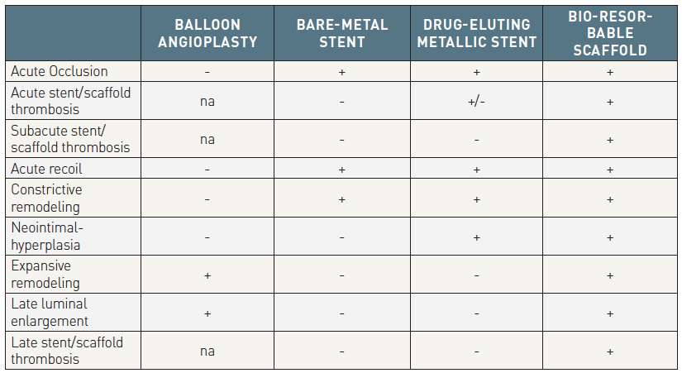

Bioresorbable scaffolds
Table 1
Potential advantage of BRS“+” implies prevented or not restricted, while “–“ implies not prevented, or restricted. Na=not applicable because of absence of stent.
Kai Ninomiya, Scot Garg, Alexandre A. Abizaid, Ron Waksman, Ashok Seth,
Joanna Wykrzykowska, John A. Ormiston, Patrick W. Serruys, Yoshinobu Onuma
©2025 Europa Group - All rights reserved.

