Slide 1


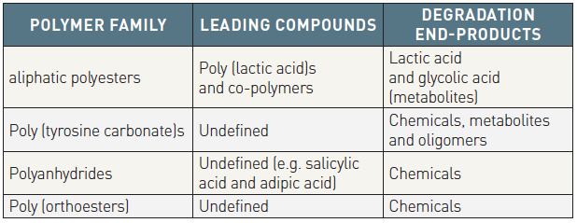

Bioresorbable scaffolds
Table 2
Leading compounds and degradation end-products according to type of polymer family
Kai Ninomiya, Scot Garg, Alexandre A. Abizaid, Ron Waksman, Ashok Seth,
Joanna Wykrzykowska, John A. Ormiston, Patrick W. Serruys, Yoshinobu Onuma
©2025 Europa Group - All rights reserved.

