Slide 1


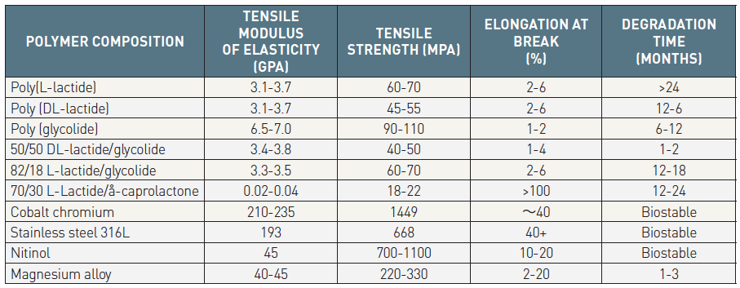

Bioresorbable scaffolds
Table 3
Mechanical properties and degradation time for different polymersTensile modulus is the tendency of an object to deform along an axis when opposing forces are applied along that axis. Tensile strength is defined as the maximum stress that a material can withstand without significant contraction in cross-section while being stretched.Gpa = Giga pascal, Mpa = Mega pascal
Kai Ninomiya, Scot Garg, Alexandre A. Abizaid, Ron Waksman, Ashok Seth,
Joanna Wykrzykowska, John A. Ormiston, Patrick W. Serruys, Yoshinobu Onuma
©2025 Europa Group - All rights reserved.

