Slide 1


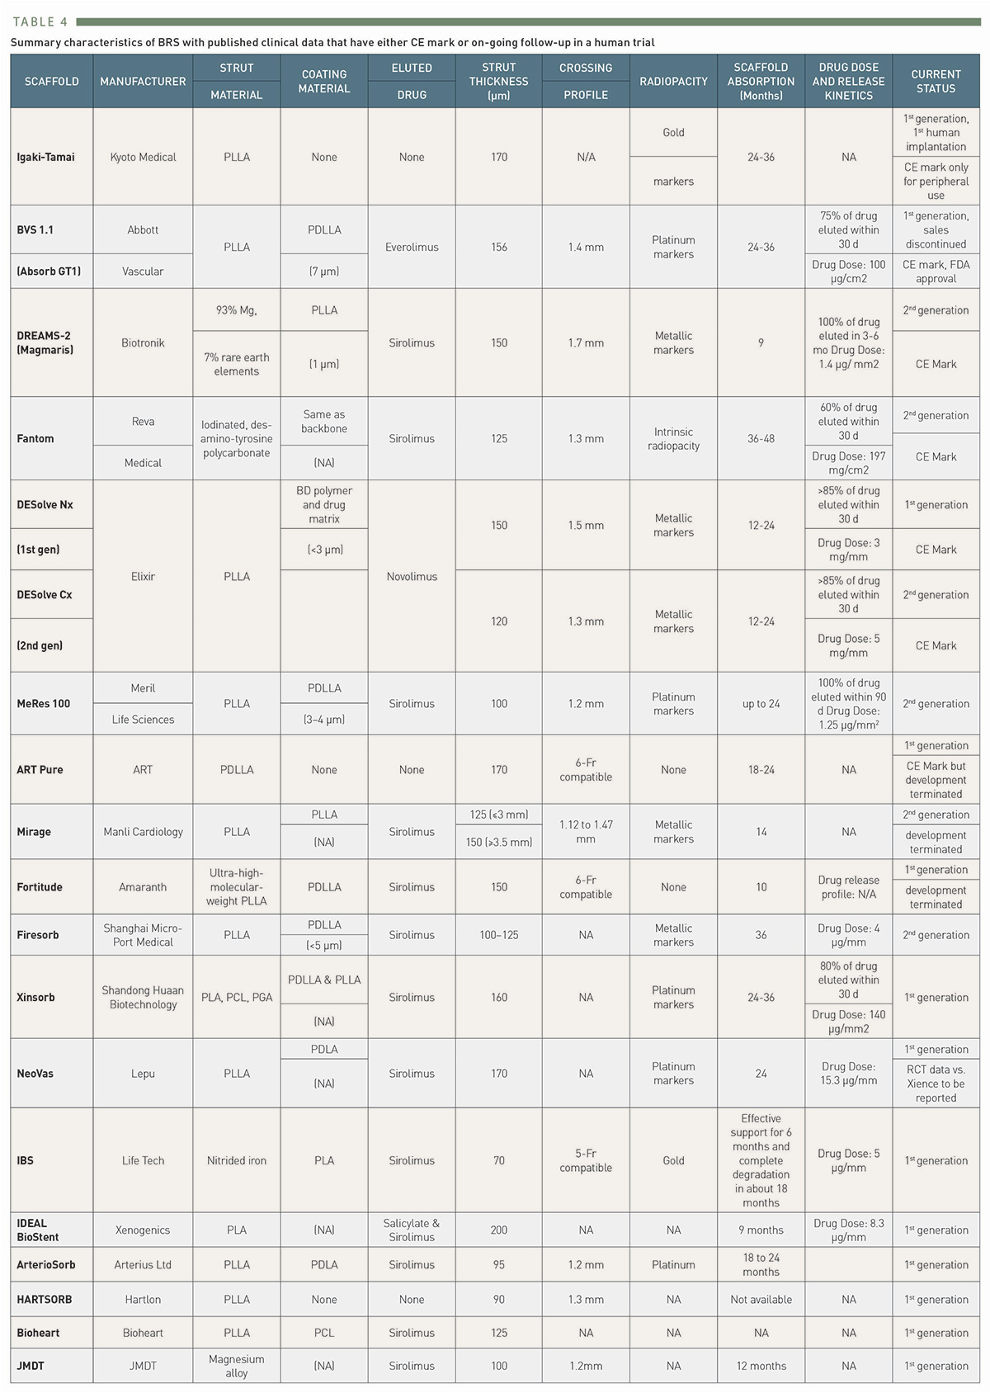

Bioresorbable scaffolds
Table 4
Summary characteristics of BRS with published clinical data that have either CE mark or on-going follow-up in a human trial
Kai Ninomiya, Scot Garg, Alexandre A. Abizaid, Ron Waksman, Ashok Seth, Joanna Wykrzykowska, John A. Ormiston, Patrick W. Serruys, Yoshinobu Onuma
©2025 Europa Group - All rights reserved.

