Slide 1


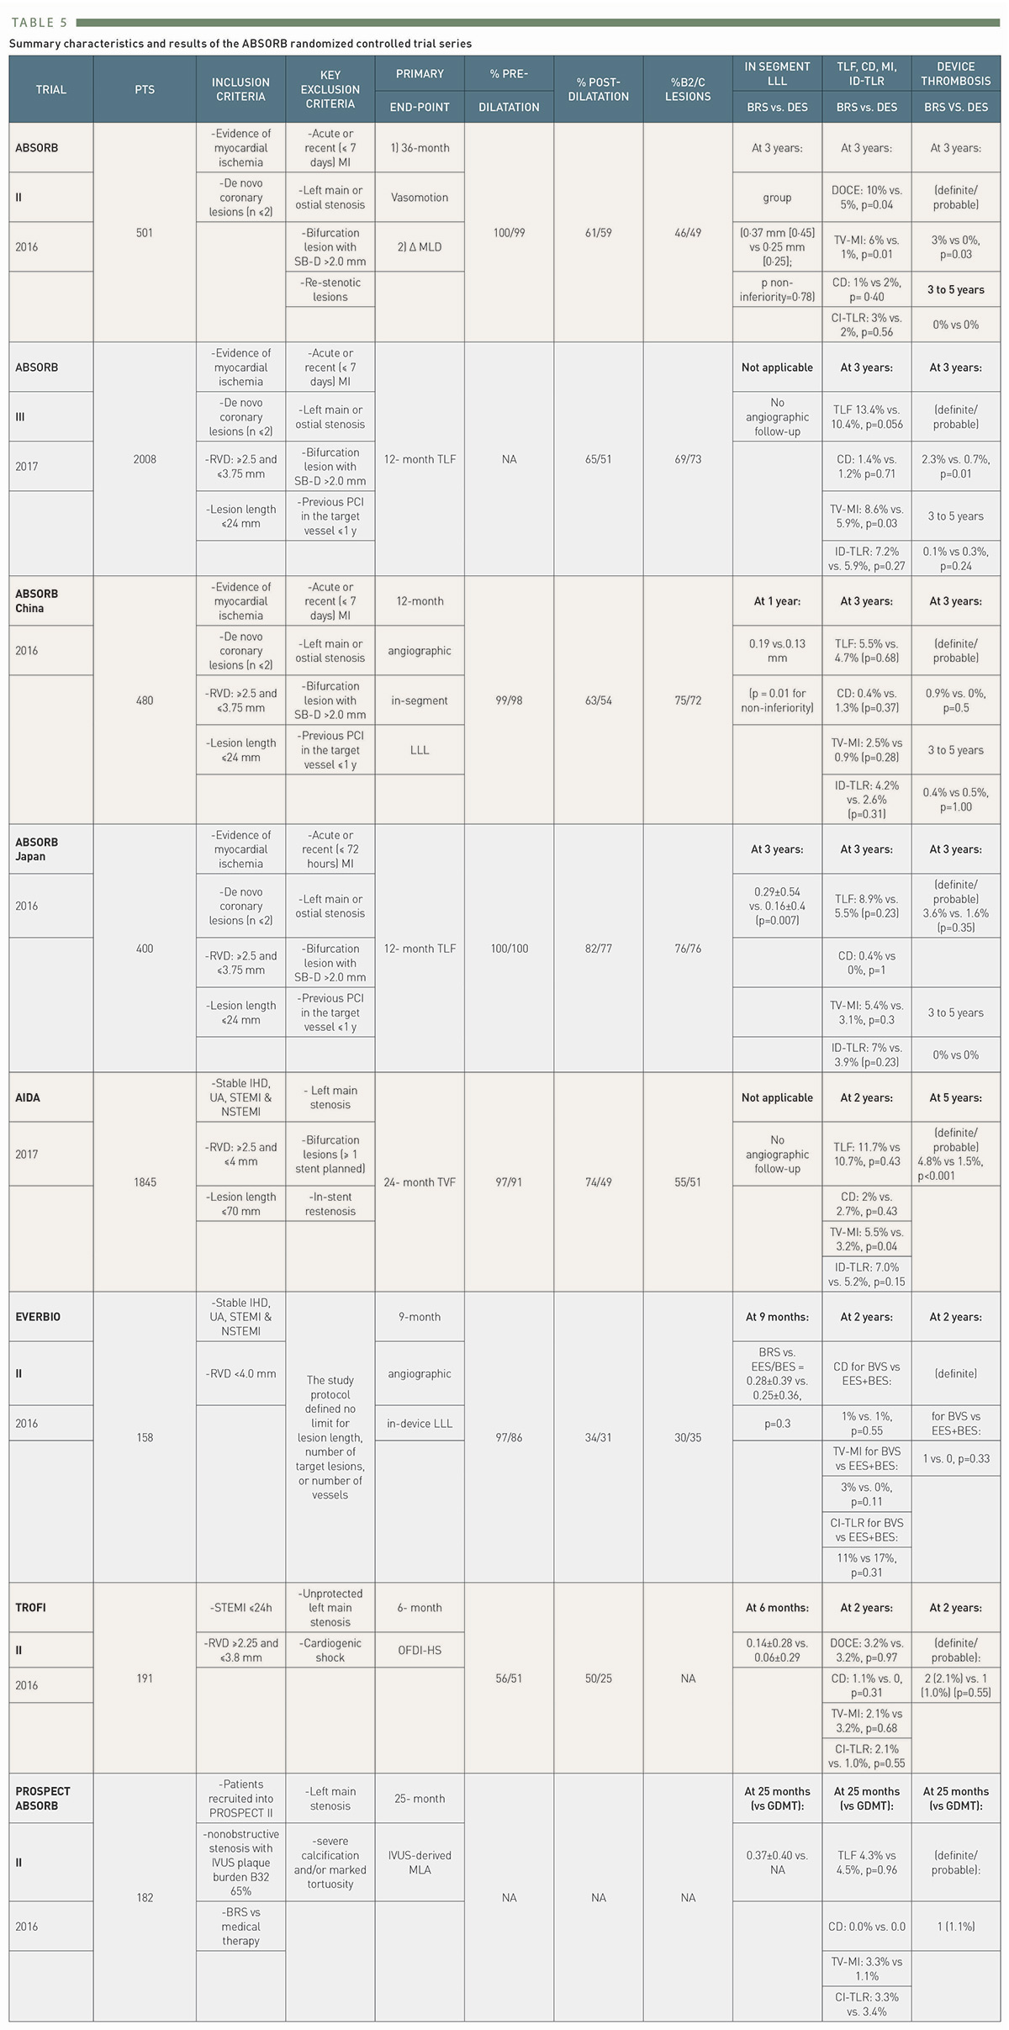

Bioresorbable scaffolds
Table 5
Summary characteristics and results of the ABSORB randomized controlled trial series
Kai Ninomiya, Scot Garg, Alexandre A. Abizaid, Ron Waksman, Ashok Seth, Joanna Wykrzykowska, John A. Ormiston, Patrick W. Serruys, Yoshinobu Onuma
©2025 Europa Group - All rights reserved.

