Slide 1


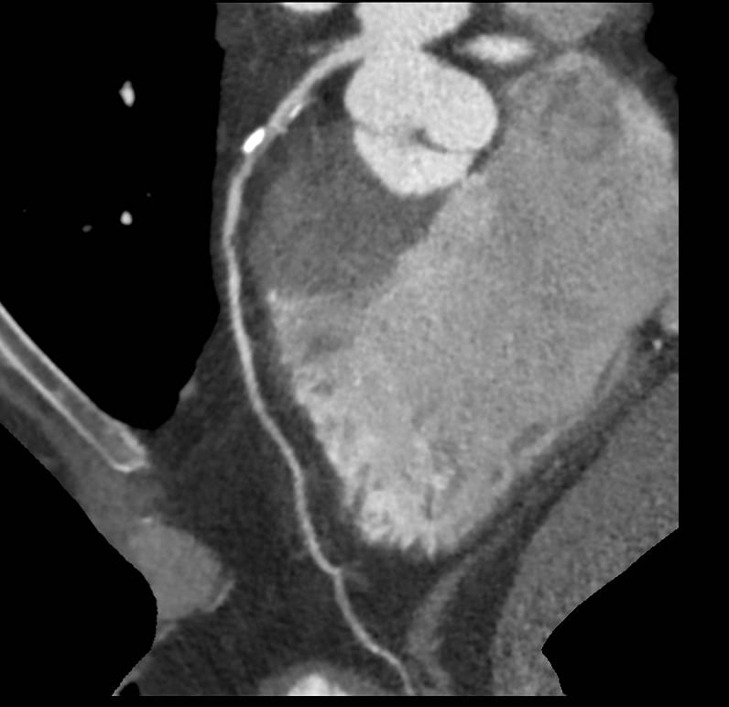

Calcified coronary lesions
Figure 1
CT coronary angiography illustrating calcium deposition in the proximal LAD.
Farrel Hellig, Pieter Van Wyk, Emanuele Barbato, Shaheen Pandie
©2025 Europa Group - All rights reserved.

