Slide 1


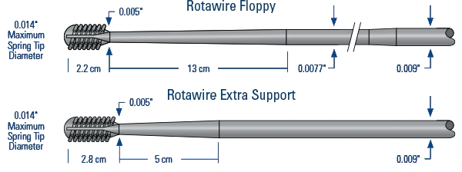

Calcified coronary lesions
Figure 10
The RotaWireTM Floppy and Extra-Support guide wires is currently the only compatible guidewires for the RotablatorTM system. Note both wires are 0.09” in diameter through the shaft of the wires.
Farrel Hellig, Pieter Van Wyk, Emanuele Barbato, Shaheen Pandie
©2025 Europa Group - All rights reserved.

