Slide 1


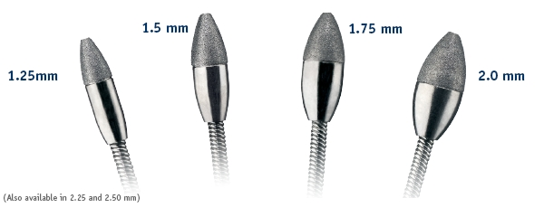

Calcified coronary lesions
Figure 11
RotablatorTM burr tip sizes range from 1.25mm to 2.5mm in diameter.
Farrel Hellig, Pieter Van Wyk, Emanuele Barbato, Shaheen Pandie
©2025 Europa Group - All rights reserved.

