Slide 1


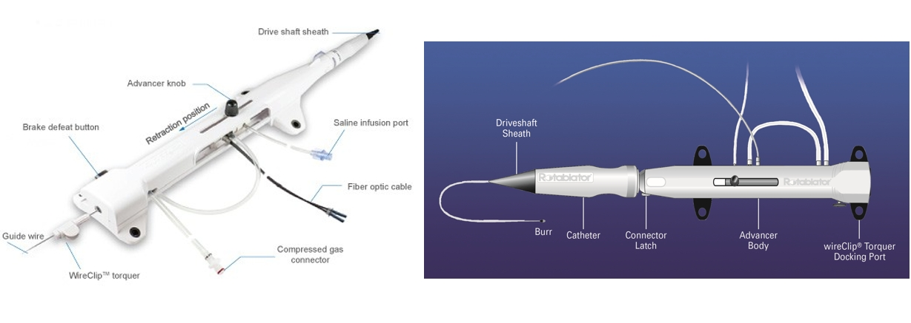

Calcified coronary lesions
Figure 12
Components of the RotaLinkTM Advancer.
Farrel Hellig, Pieter Van Wyk, Emanuele Barbato, Shaheen Pandie
©2025 Europa Group - All rights reserved.

