Slide 1


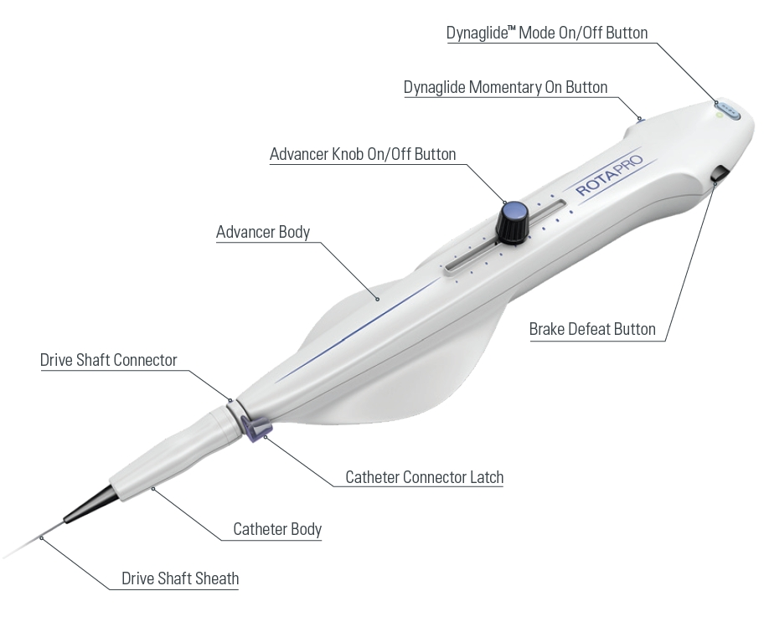

Calcified coronary lesions
Figure 13
Components of the RotaproTM Advancer. The main new features of this console compared to the RotaLinkTM Advancer is the incorporation of the On/Off button on the advancer knob as well as the DynaglideTM On/Off button into the RotaproTM Advancer.
Farrel Hellig, Pieter Van Wyk, Emanuele Barbato, Shaheen Pandie
©2025 Europa Group - All rights reserved.

