Slide 1


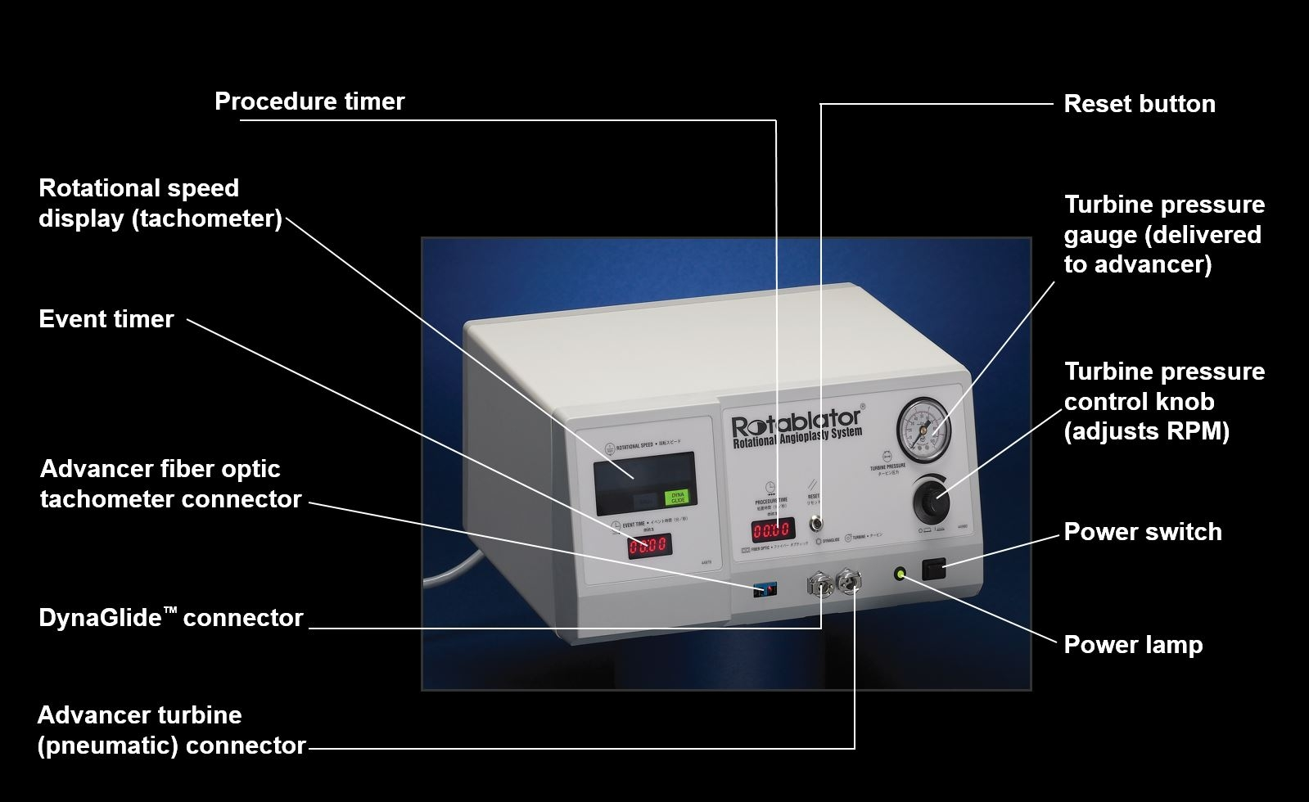

Calcified coronary lesions
Figure 14
Components of the RotablatorTM console.
Farrel Hellig, Pieter Van Wyk, Emanuele Barbato, Shaheen Pandie
©2025 Europa Group - All rights reserved.

