Slide 1


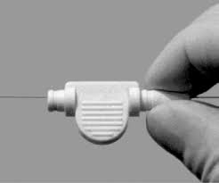

Calcified coronary lesions
Figure 18
The WireClipTM is the only torquer compatible with the 0.09 inch RotaWireTM Floppy and Extra-Support wires.
Farrel Hellig, Pieter Van Wyk, Emanuele Barbato, Shaheen Pandie
©2025 Europa Group - All rights reserved.

