Slide 1


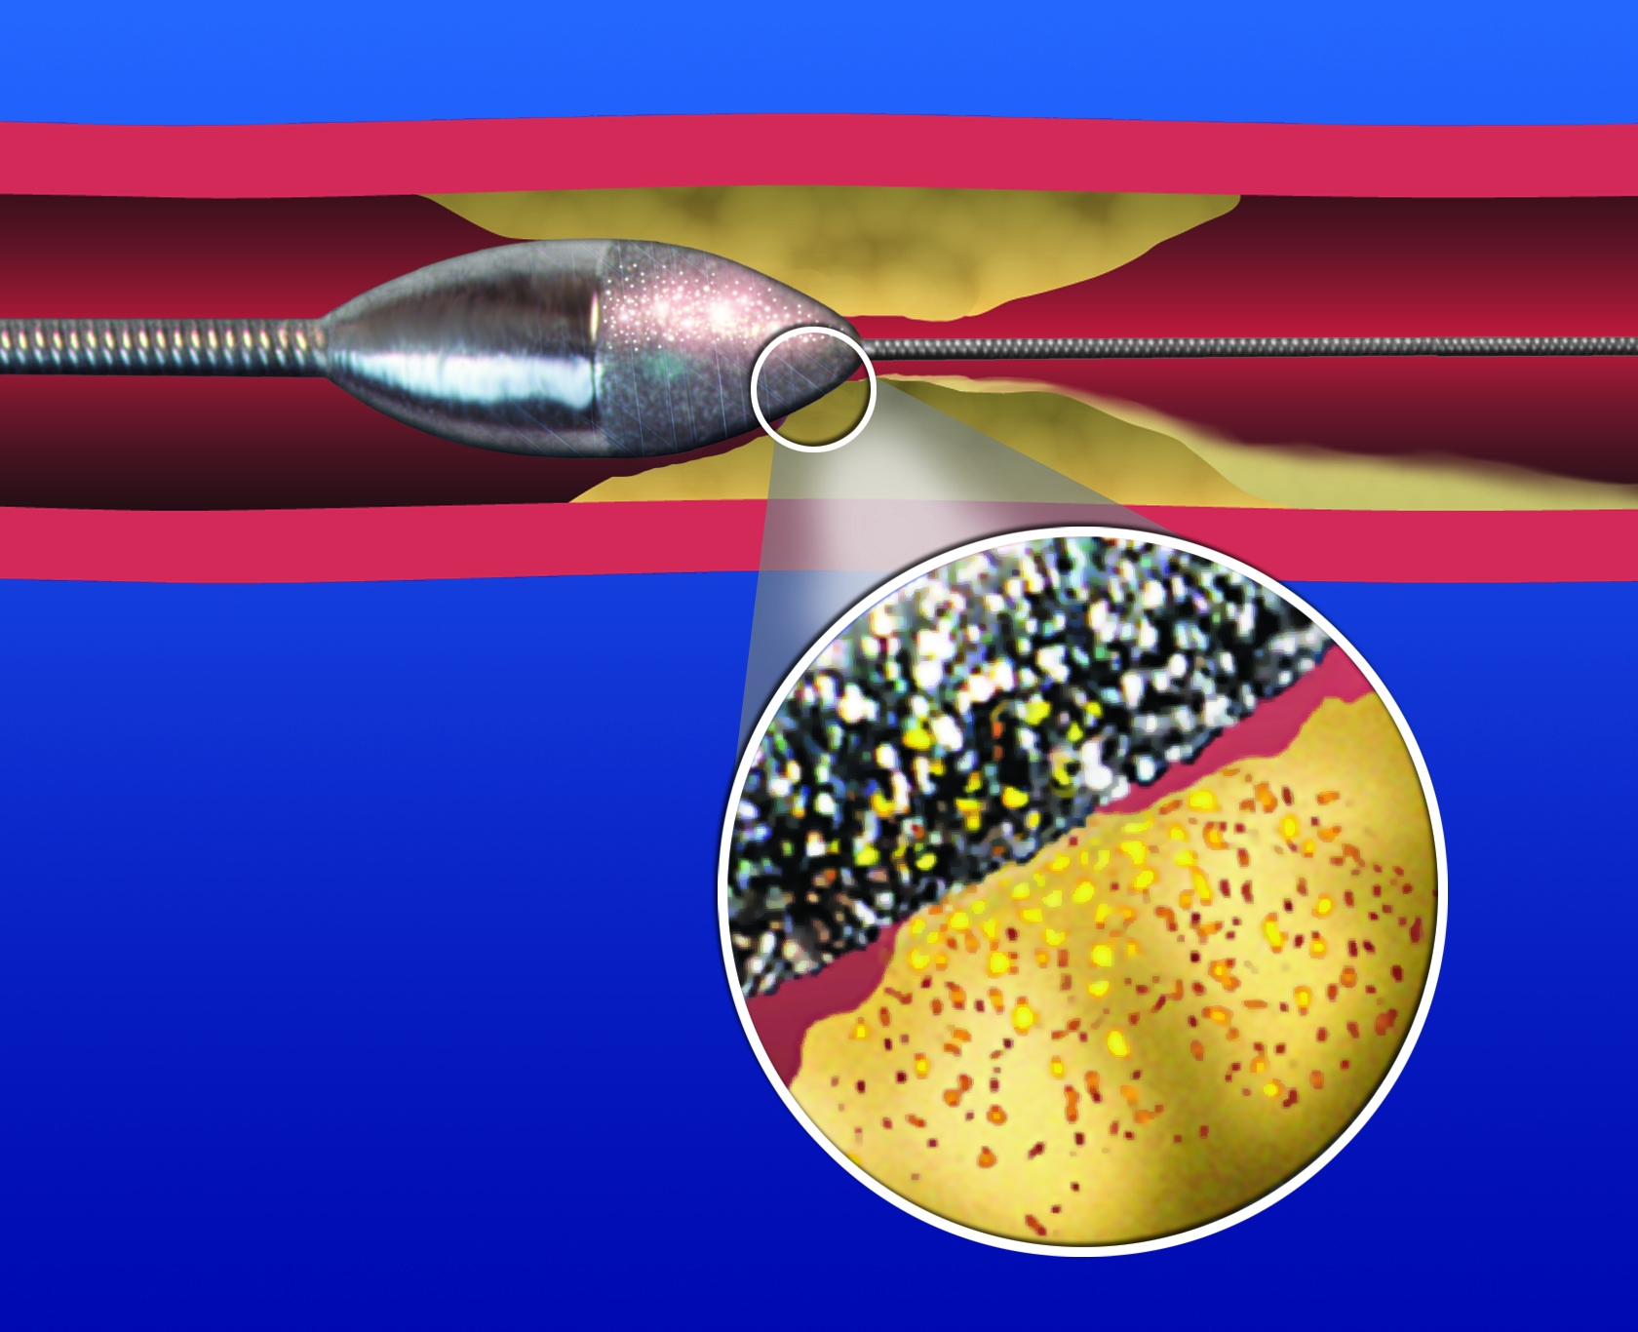

Calcified coronary lesions
Figure 19
The front halve of the elliptical rotational atherectomy bur tip is covered with a fine diamond crust protruding approximately 5 microns from the surface of the burr. This design results in differential ablation of calcified lesions creating microparticles of 5-10 microns that is able to pass through the capillary bed.
Farrel Hellig, Pieter Van Wyk, Emanuele Barbato, Shaheen Pandie
©2025 Europa Group - All rights reserved.

