Slide 1


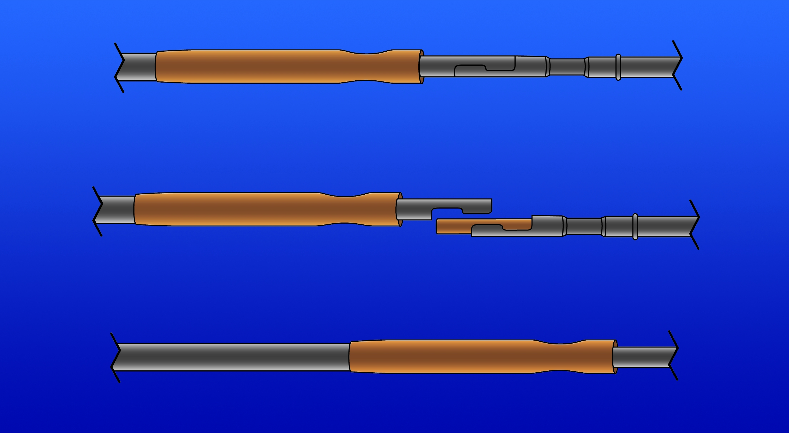

Calcified coronary lesions
Figure 21
RA burr exchange. Connecting the drive shaft of the burr to the advancer requires exposure of the advancer’s drive shaft by sliding the advancer knob all the way forward and then locking the knob. The copper sheath on the burr’s driveshaft is then pushed towards the burr tip to expose the lock mechanism. The interlocking “jaws”of both drive shafts are then snapped together and the copper sheath is pulled back towards the advancer to cover the locking mechanism. The advancer knob is then unlocked and withdrawn to the rear and re-locked. Then the catheter body of the burr is pushed over the drive shaft into then front port of the advancer until the system clicks to lock.
Farrel Hellig, Pieter Van Wyk, Emanuele Barbato, Shaheen Pandie
©2025 Europa Group - All rights reserved.

