Slide 1


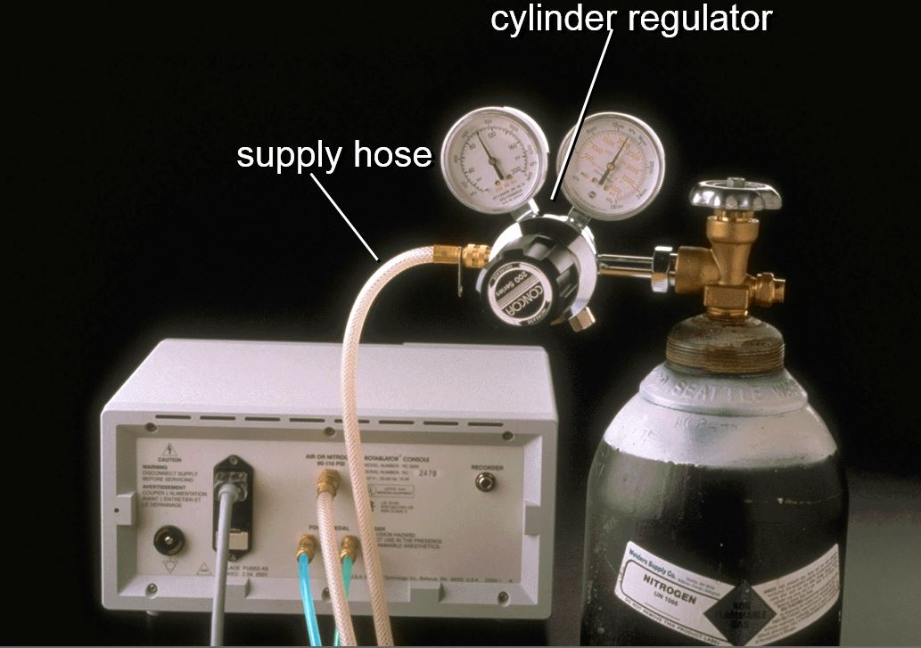

Calcified coronary lesions
Figure 22
Rear components of the RotablatorTM console and connection with gas cylinder.
Farrel Hellig, Pieter Van Wyk, Emanuele Barbato, Shaheen Pandie
©2025 Europa Group - All rights reserved.

