Slide 1


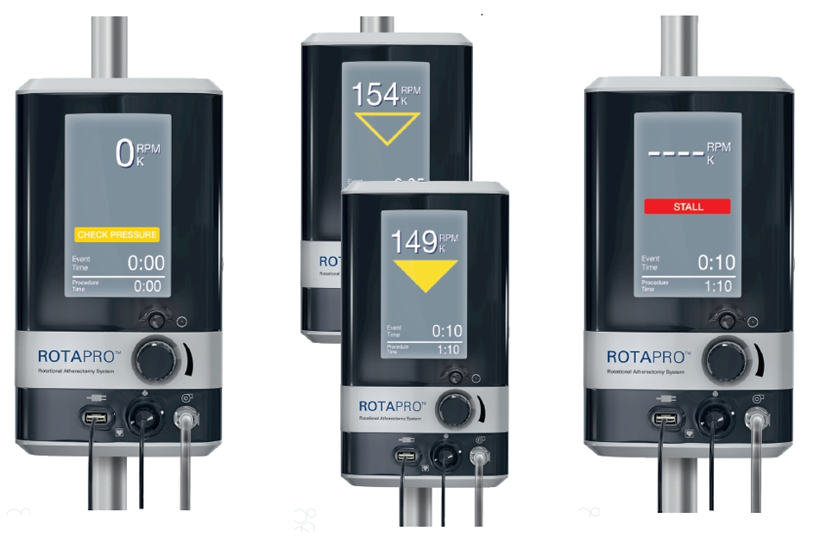

Calcified coronary lesions
Figure 23
Warning indicators on the RotaproTM console. Inadequate pressure to the console is displayed as a yellow “check pressure” indication. Deceleration of more than 5000 rpm is indicated as yellow triangle outline, deceleration more than 10000 rpm as a solid yellow triangle and deceleration of more than 15000 rpm as a red “stall” indication.
Farrel Hellig, Pieter Van Wyk, Emanuele Barbato, Shaheen Pandie
©2025 Europa Group - All rights reserved.

