Slide 1


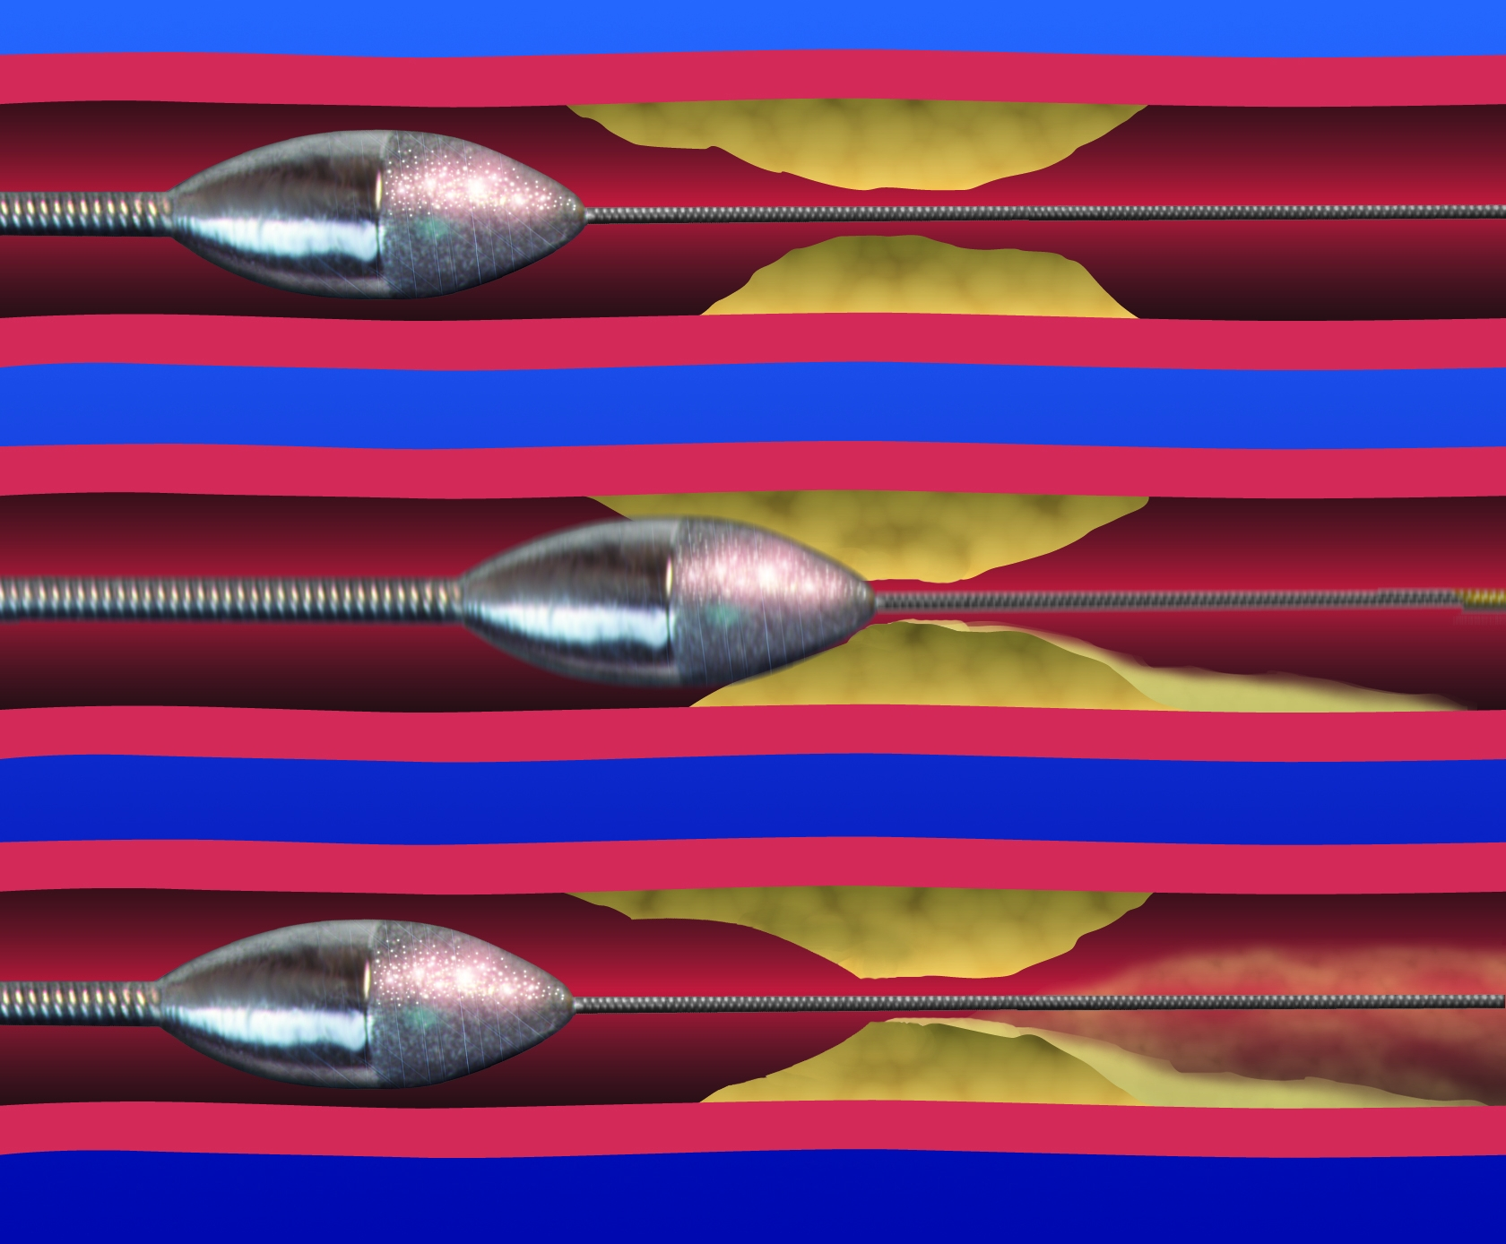

Calcified coronary lesions
Figure 25
Pecking motion of rotational atherectomy. After activation the burr tip is advanced to make contact with the lesion for 1-2seconds at a time then withdrawn to proximal to the lesion.
Farrel Hellig, Pieter Van Wyk, Emanuele Barbato, Shaheen Pandie
©2025 Europa Group - All rights reserved.

