Slide 1


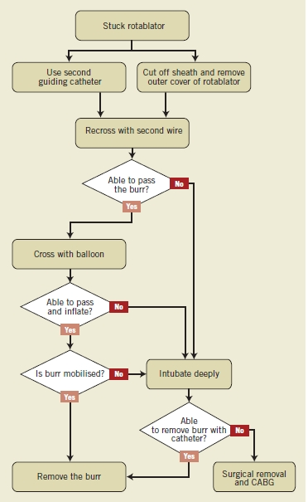

Calcified coronary lesions
Figure 26
Proposed algorithm for removal of a stuck or trapped burr during rotational atherectomy.
Farrel Hellig, Pieter Van Wyk, Emanuele Barbato, Shaheen Pandie
©2025 Europa Group - All rights reserved.

