Slide 1


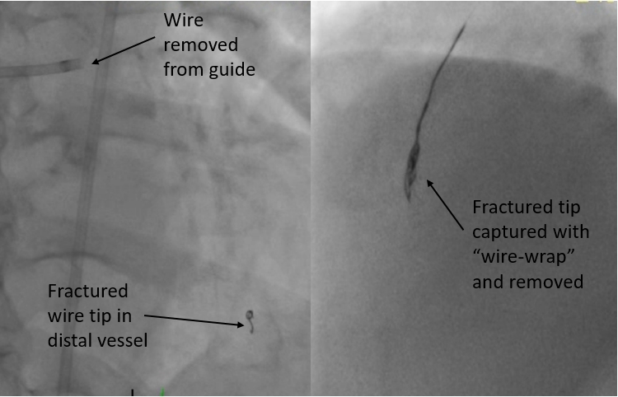

Calcified coronary lesions
Figure 27
Fracture of the distal tip of a RotaWireTM floppy following RA LAD. This wire fragment was retrieved by entrapment of the fragment and withdrawal with the “wire-wrap” technique as shown in the right image.
Farrel Hellig, Pieter Van Wyk, Emanuele Barbato, Shaheen Pandie
©2025 Europa Group - All rights reserved.

